Slide 1


ZombieTime – JSR 310 for the Undead
Stephen Chin (@steveonjava)
Java Technology Evangelist
JavaOne Conference Chair

Slide 2
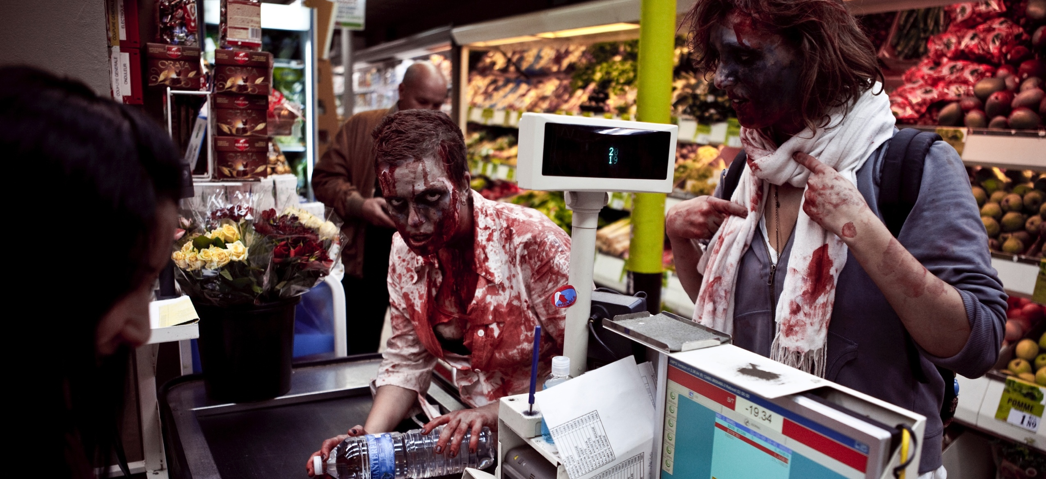
We just want to fit in
https://www.flickr.com/photos/philippeleroyer/4071842319/

Slide 3

But humans are scared of us!
https://www.flickr.com/photos/moira_fee/5632351014/

Slide 4

Is it just because we eat brains?
https://www.flickr.com/photos/dwilliss/7861599590/

Slide 5
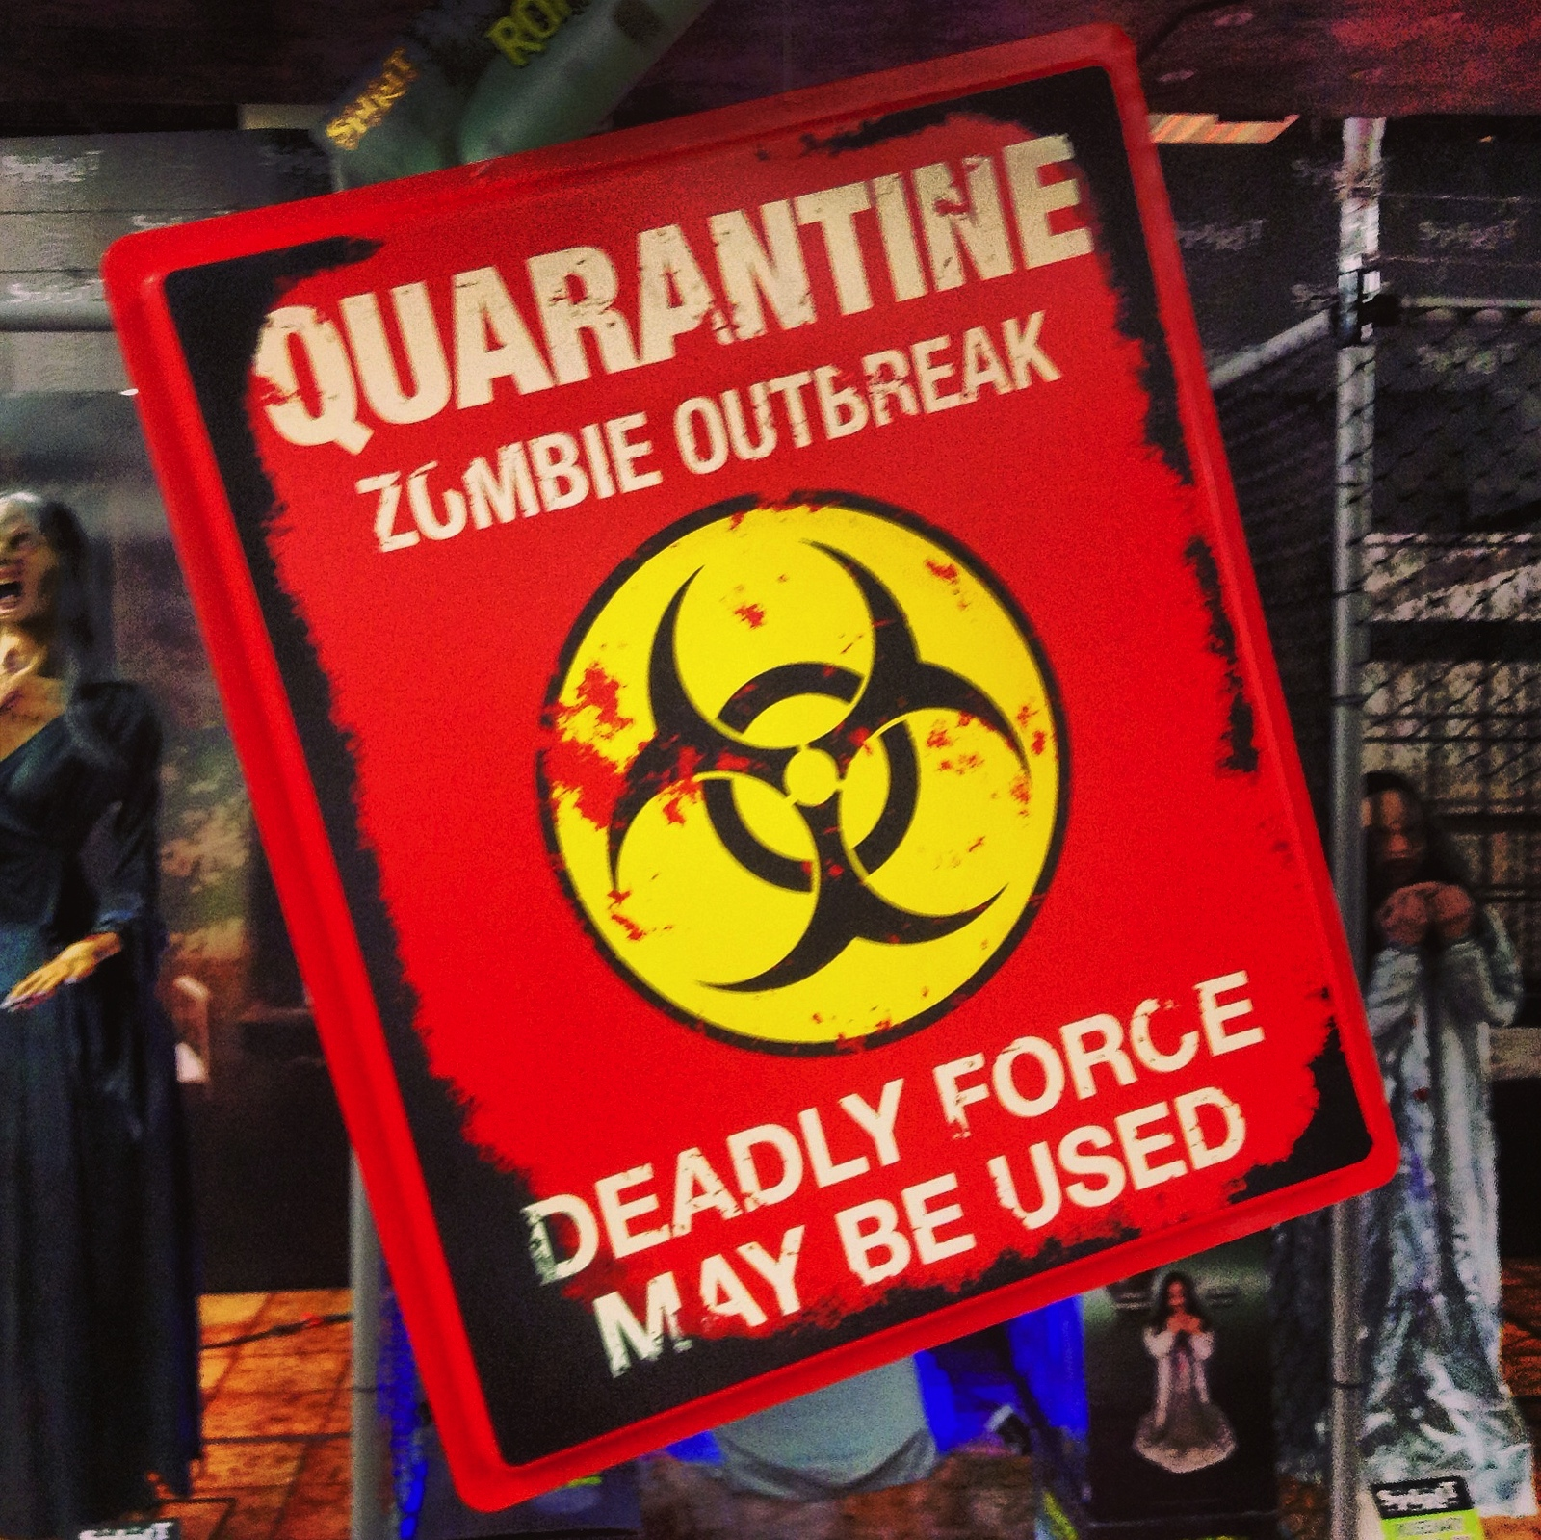
They quarantine us…
https://www.flickr.com/photos/jeepersmedia/11883875415/

Slide 6
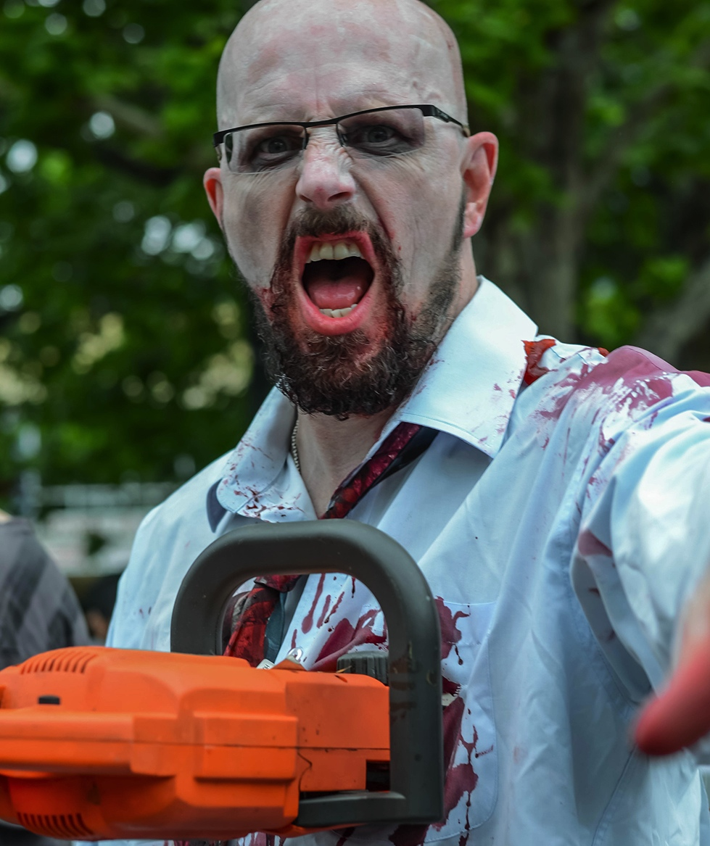
And attack us with weapons…
https://www.flickr.com/photos/nichpics/10628256503/

Slide 7
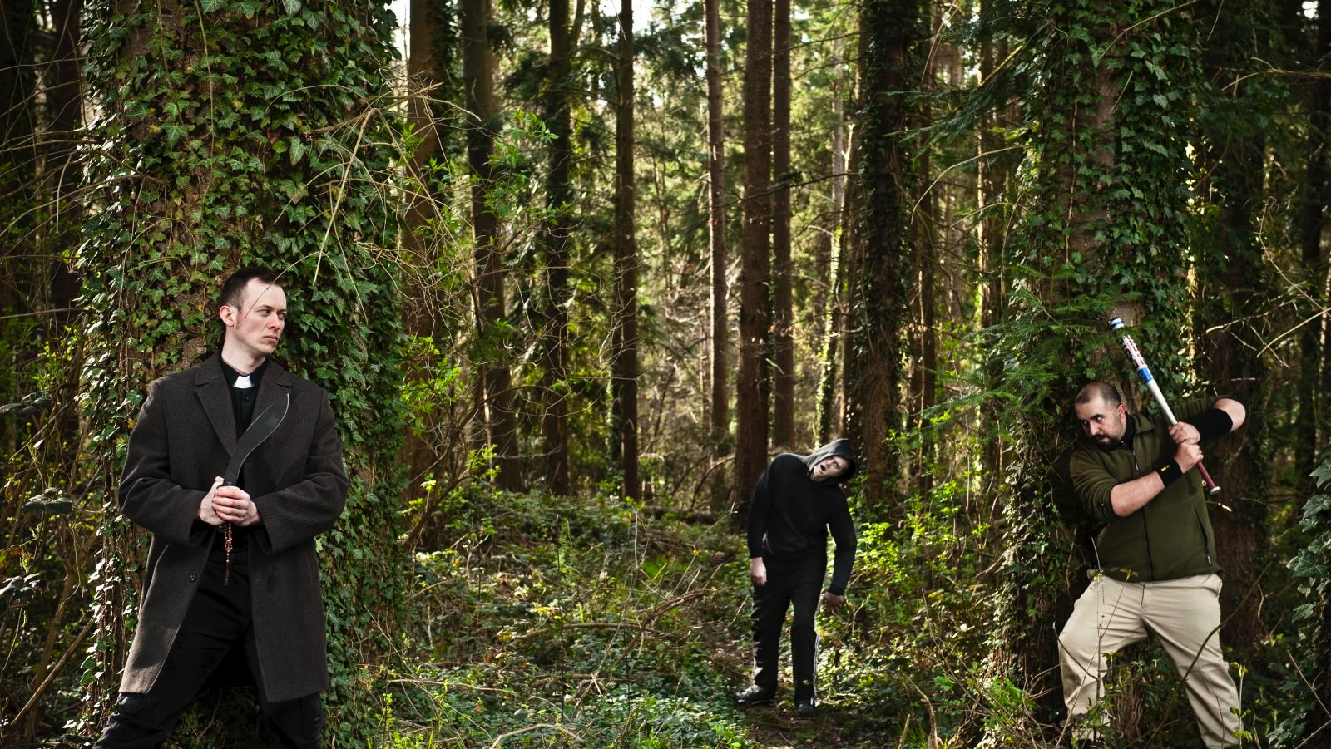
But when it is us vs. them…
https://www.flickr.com/photos/icedsoul/4511648609/in/photostream/

Slide 8
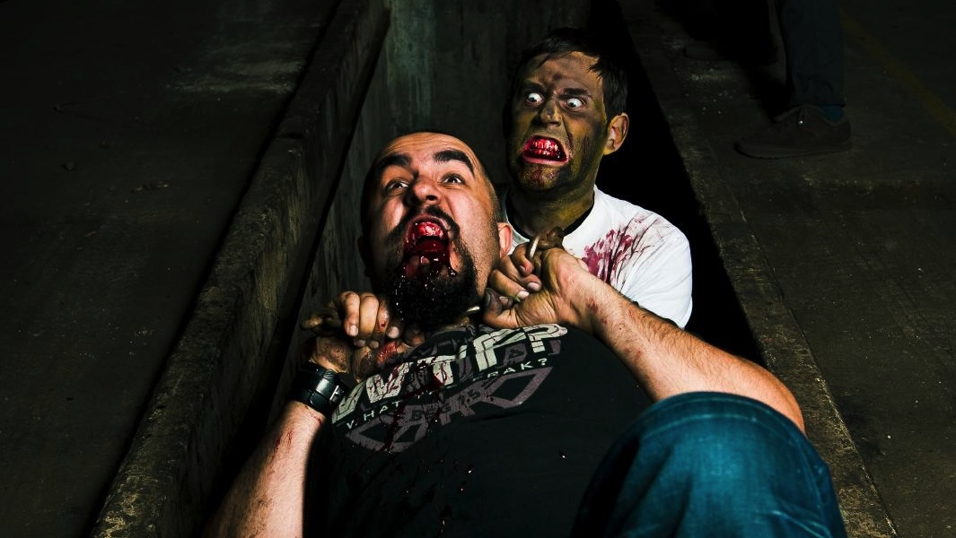
Humans don't stand a chance!
https://www.flickr.com/photos/icedsoul/4470494133/

Slide 9
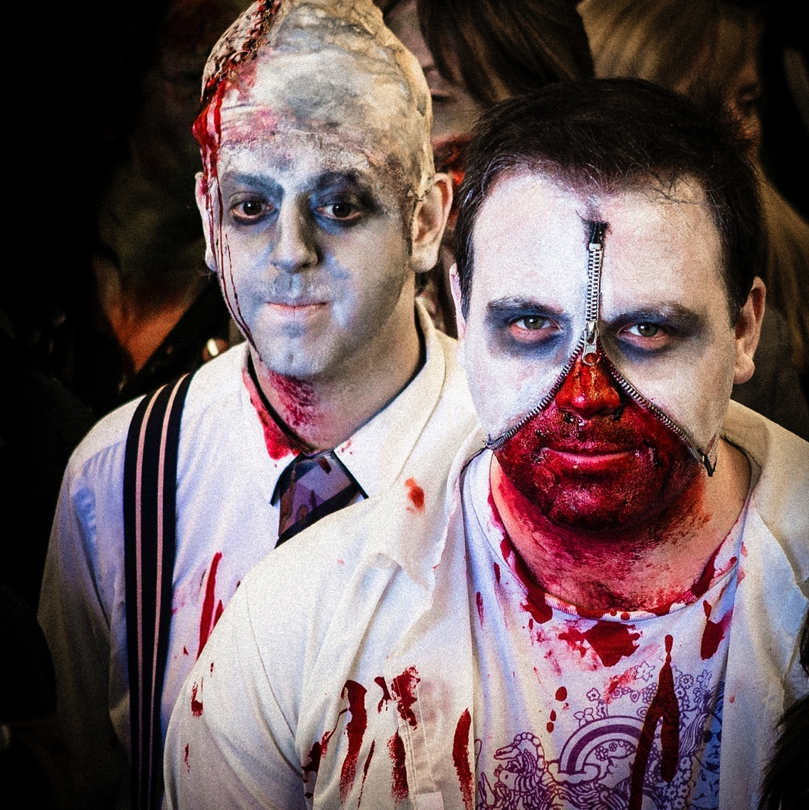
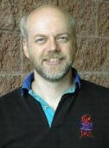
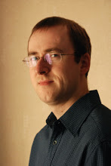
JSR 310, a New Weapon Against the Humans!
Roger Riggs
Our researchers have come up with a new weapon against the humans!
Modern API – Zombies type slow, so we need a fluent API with easy conversions
Thread safe – Don't get caught in a deadlock with armed humans!
Simplified Time Zone Handling – Coordinated global attacks!
Stephen Colebourne
https://www.flickr.com/photos/soul_stealer/8249718101/

Slide 10
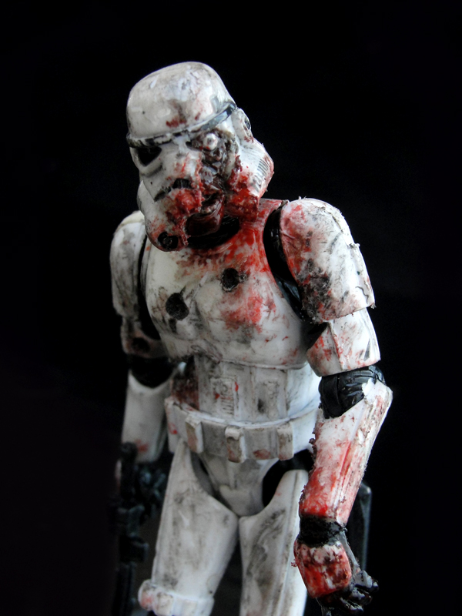
Don't repeat this failure…
// hit the humans while they are celebrating!
Date attackDate = new Date(2013, 12, 25);
+1900
0-based
(No Range Checking!)
3914
In the year 3913
https://www.flickr.com/photos/frogdna/6948427148/

Slide 11
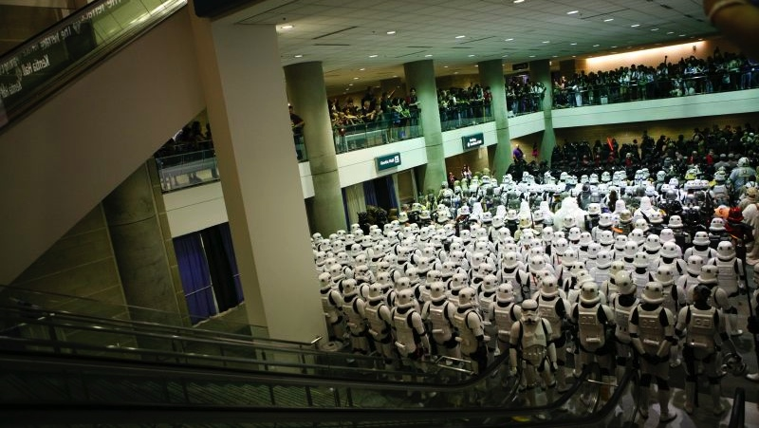
January 25th, 3914 : Failed Zombie Trooper Invasion
I hope you took your Zombie shot, junior.
I think we are surrounded…
Why are we still using escalators 2000 years in the future?
https://www.flickr.com/photos/starwarsblog/516181007/

Slide 12



ZombieTime – Undead Trainer for JSR 310

Slide 13
Basic Concepts
LocalDate, LocalTime, LocalDateTime
Represents a calendar date, time, or both
Instant
Amount of time since the epoch – ideal for timestamps and calculations
Period
A span of time between two dates (goes well with LocalDateTime)
Duration
A precise span of time (goes well with Instants)

Slide 14
Creating Dates and Times
Now
LocalDate.now()
Static
LocalDate.of(2013, Month.DECEMBER, 25) // Use the enums!
LocalTime.of(11, 30, 5, 999_999_999) // Time to go to work…
LocalDateTime.of(2013, Month.DECEMBER, 25, 11, 30, 5, 999_999_999) // Even on Christmas
Parsing
LocalDate.parse()
Conversion
new Date().toInstant()
Calendar.getInstance().toInstant()

Slide 15
PixelatedClock
Timeline clockTimeline = new Timeline(
new KeyFrame(Duration.millis(1),
actionEvent -> {
LocalTime now = LocalTime.now();
}));

Slide 16
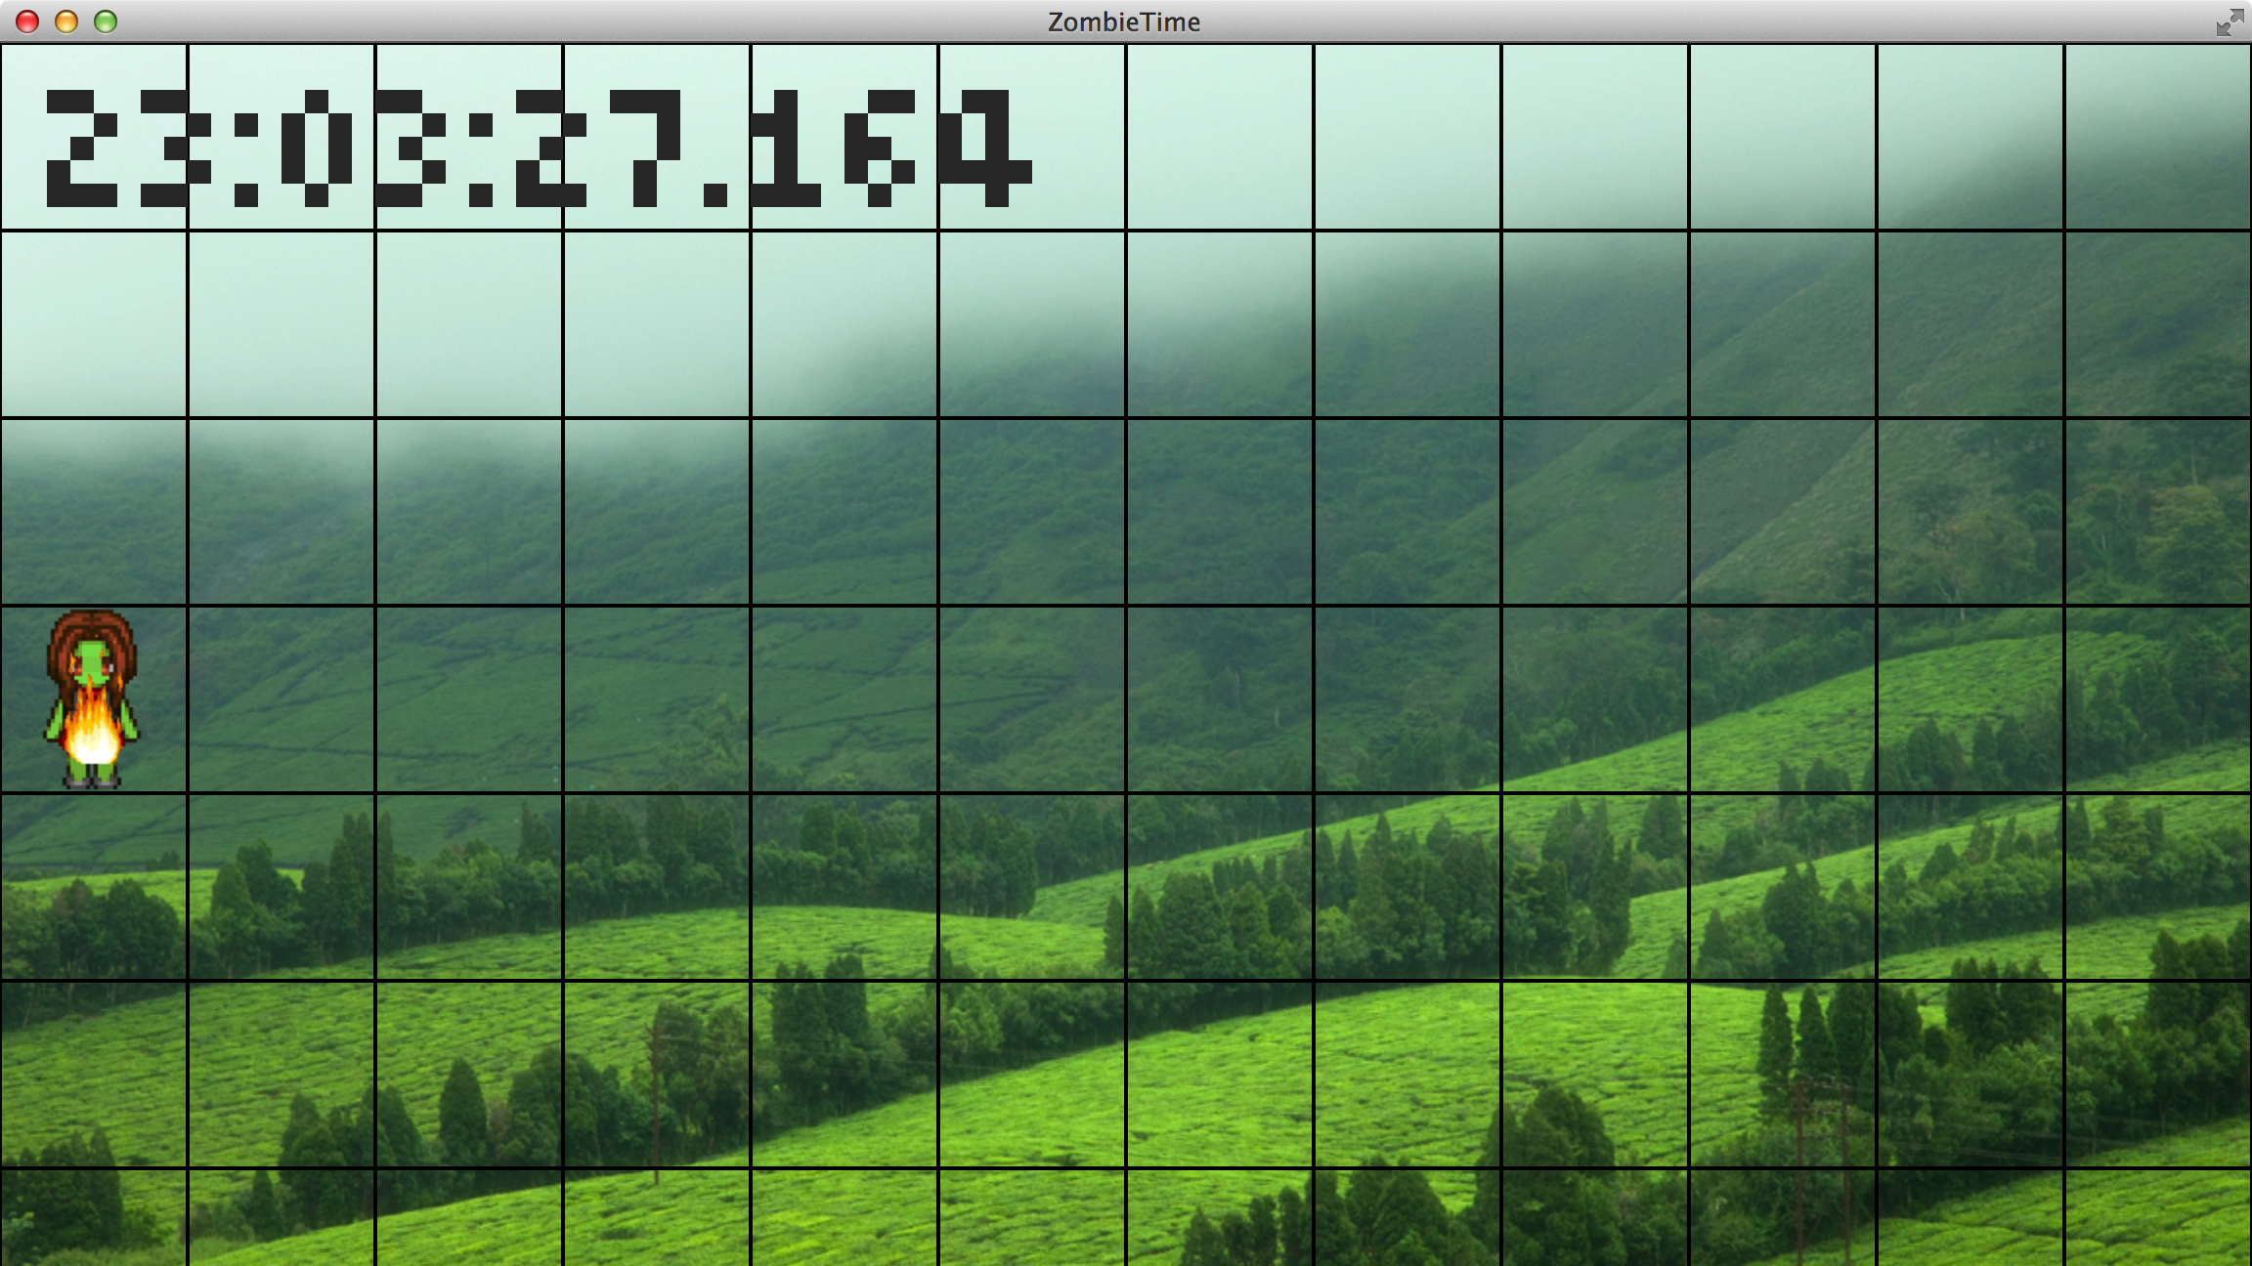

Slide 17
Formatting Dates and Times
Constants
DateTimeFormatter.BASIC_ISO_DATE // '2011-12-03+01:00'
DateTimeFormatter.ISO_TIME // '10:15:30+01:00'
DateTimeFormatter.ISO_DATE_TIME // '2011-12-03T10:15:30+01:00[Europe/Paris]'
DateTimeFormatter.ISO_WEEK_DATE // 2012-W48-6'
Localized Formatters
DateTimeFormatter.ofLocalizedTime(FormatStyle.SHORT)
Strings
date.toString("d MMM uuuu") // '25 Dec 2014'
Formatters are immutable and thread-safe for reuse!

Slide 18
Localized PixelatedClock
DateTimeFormatter clockFormat = DateTimeFormatter.ofLocalizedTime(FormatStyle.SHORT);
Timeline clockTimeline = new Timeline(
new KeyFrame(Duration.millis(1),
actionEvent -> {
setText(now.format(clockFormat));
}));

Slide 19
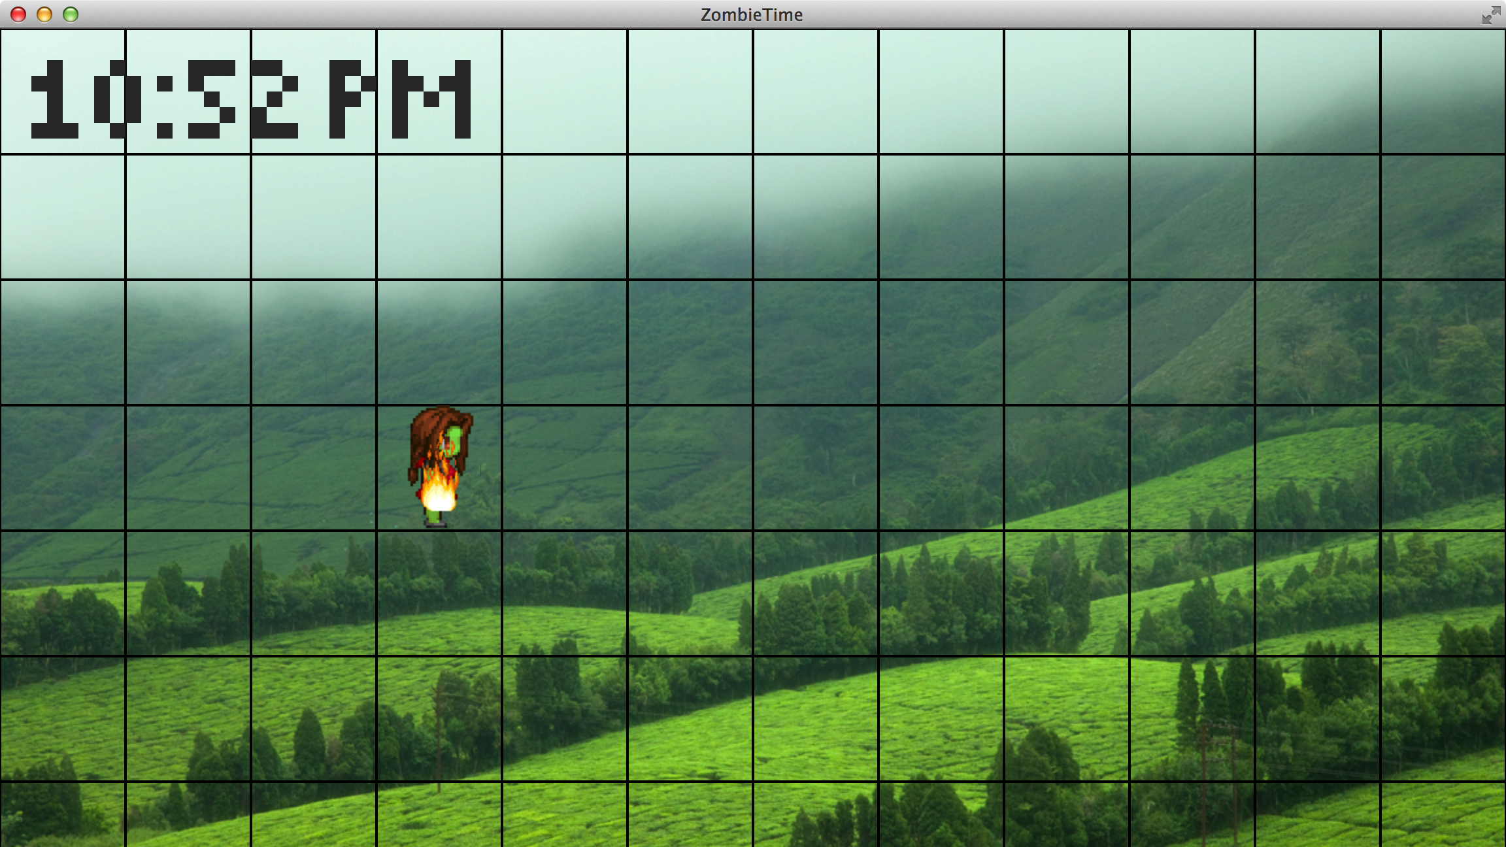

Slide 20
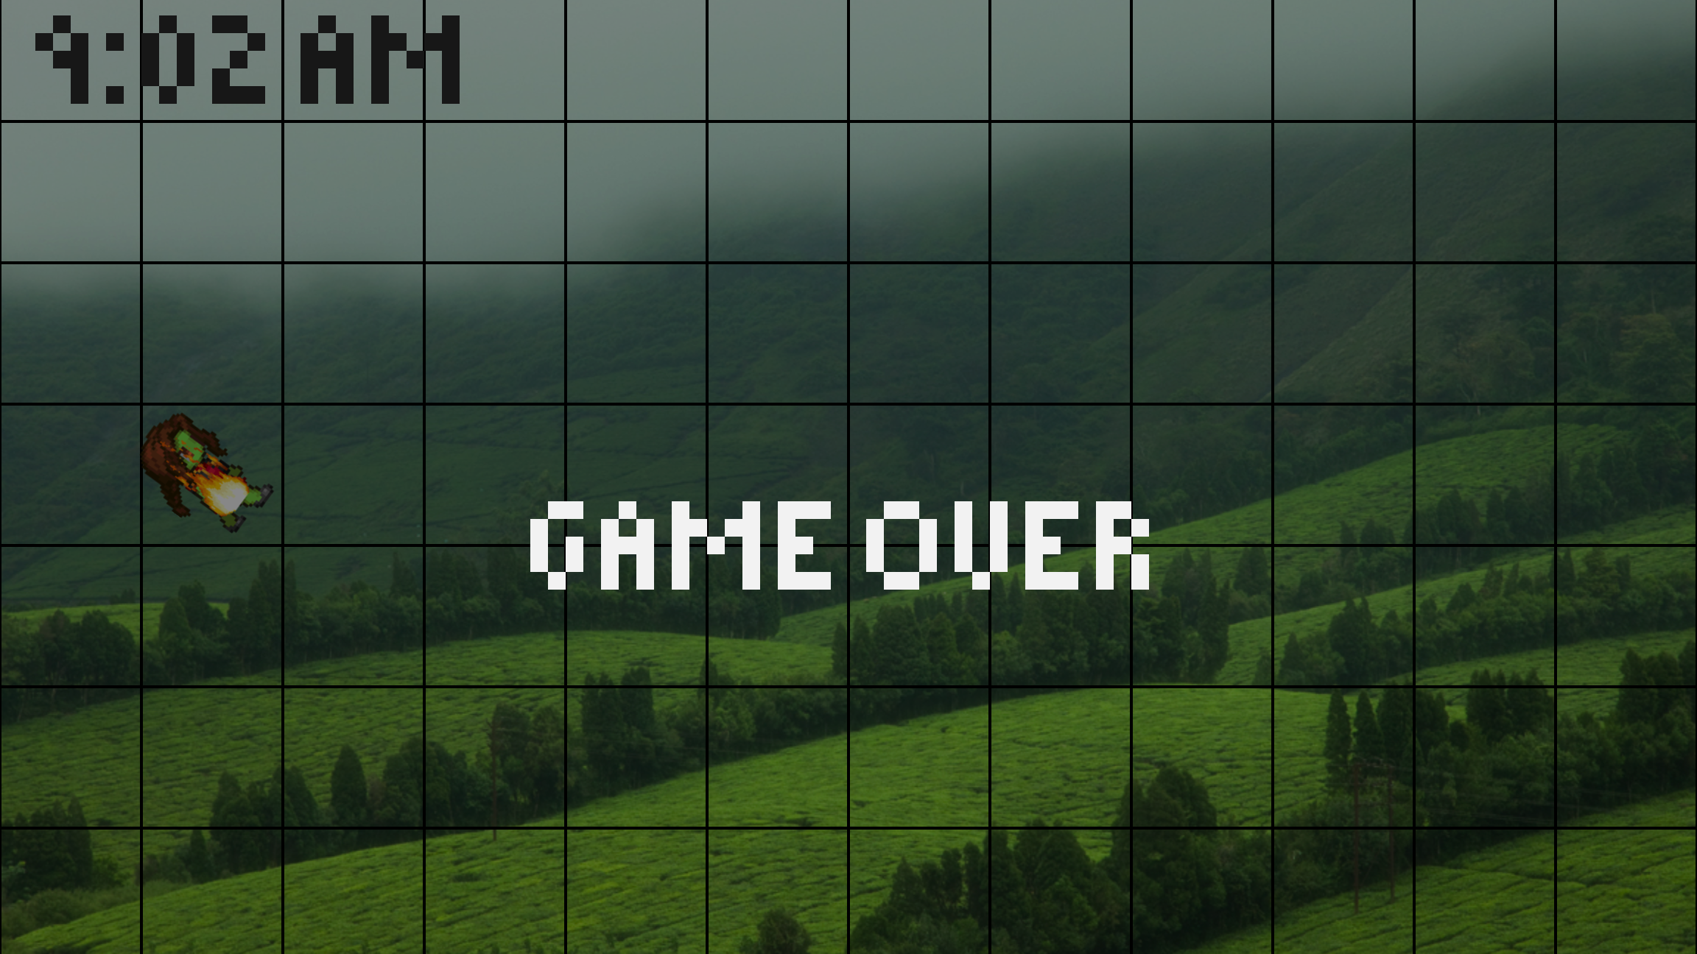

Slide 21
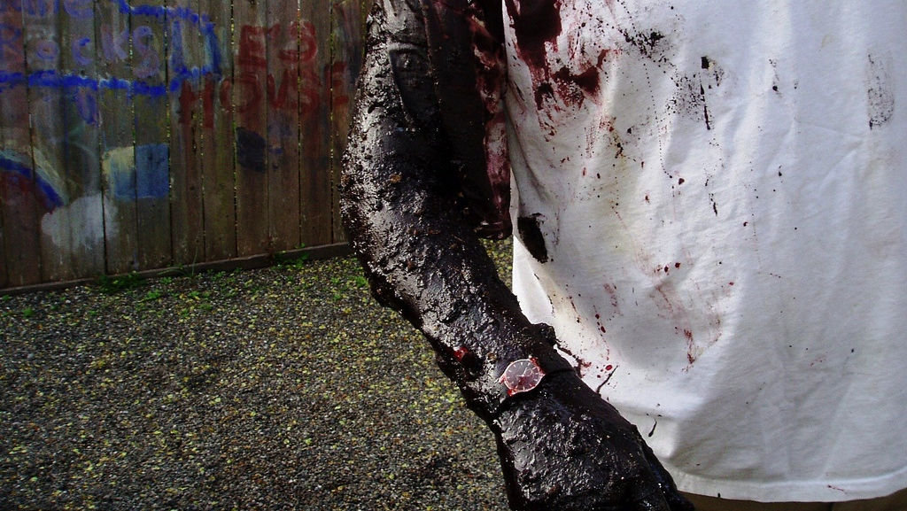
I HATE SUNBURN!
https://www.flickr.com/photos/rosenwald/4534092922/

Slide 22
Using LocalTime/LocalDate
Comparing Times/Dates:
time.isBefore(LocalTime.NOON) // before noon
date.isAfter(LocalDate.ofYearDay(2014, 365 / 2)) // appx. halfway through the year
Year Info:
date.getYear()
date.getDayOfYear()
date.lengthOfYear()
date.isLeapYear()
Time Info:
time.getHour() / time.getMinute() / time.getSecond() / time.getNano()

Slide 23
Hide from the sunlight!
public BooleanProperty isNight = new SimpleBooleanProperty();
isNight.setValue(now.isAfter(LocalTime.of(6, 0)) && now.isBefore(LocalTime.of(19, 0)));
underground.bind(Main.pixelatedClock.isNight.not());

Slide 24
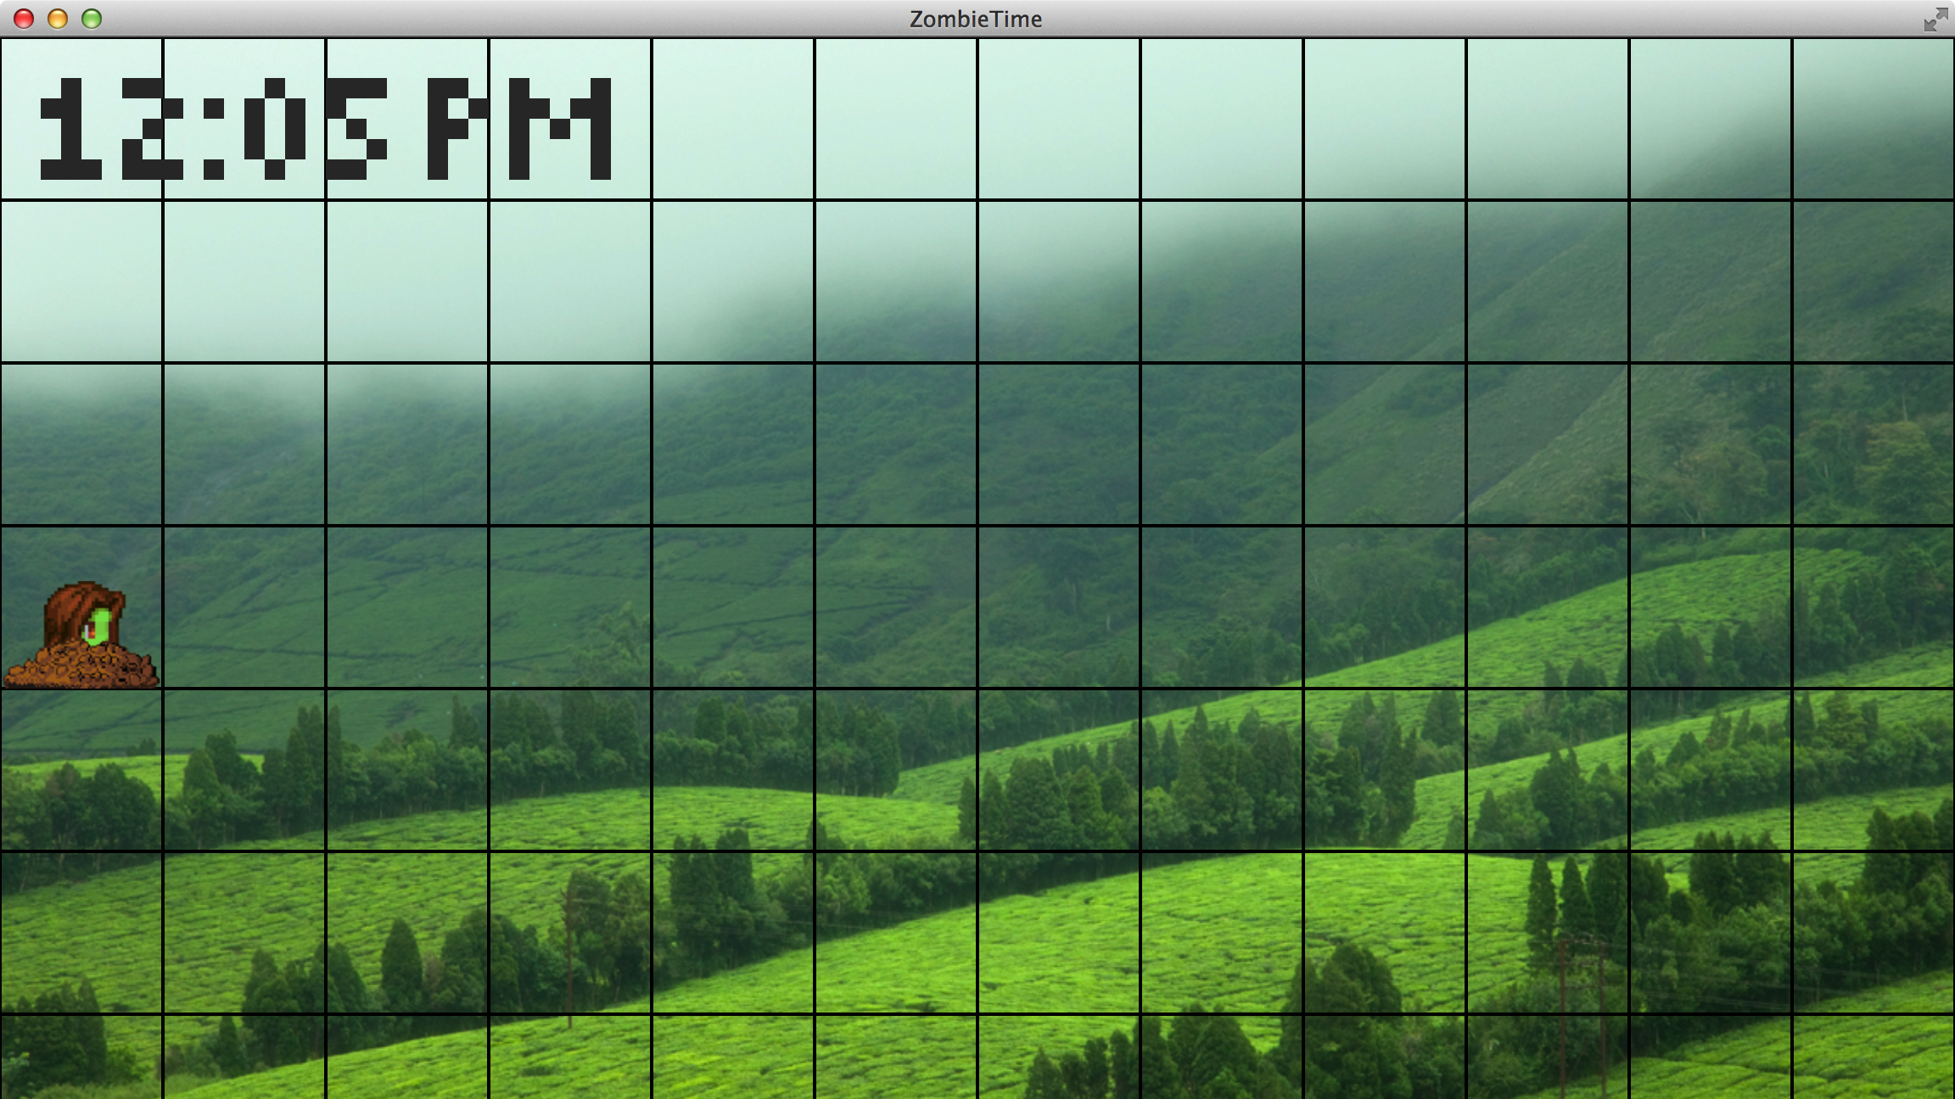

Slide 25
Let's Add Some Villagers!
children.add(new SpriteView.Fred(new Location(8, 2)));
children.add(new SpriteView.Sam(new Location(9, 4)));
children.add(new SpriteView.Ted(new Location(7, 6)));
children.add(new SpriteView.Sarah(new Location(5, 4)));
children.add(new SpriteView.Jenn(new Location(6, 5)));

Slide 26
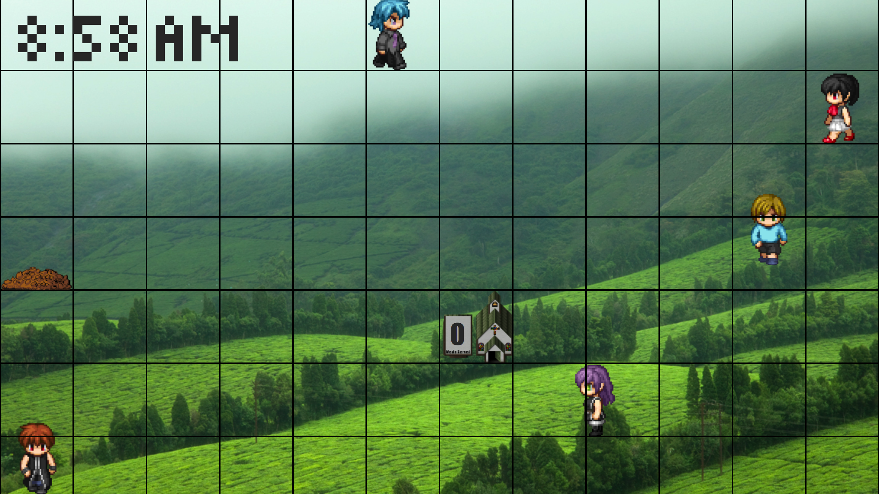
Ouch! Don't step on me

Slide 27
Using Time Zones
Creating ZoneIds:
zoneId = ZoneId.of("Europe/Paris");
zoneId = ZoneId.of(ZoneId.SHORT_IDS.get("EST"));
zoneId = ZoneOffset.ofHours(-8);
Using ZoneIds:
dateTime.now(zoneId);
dateTime.atZone(zoneId);
Clock.system(zoneId);

Slide 28
Make it Night!
ZoneId zoneId = ZoneId.of("Europe/London");
LocalTime now = LocalTime.now(zoneId);

Slide 29
Make it Night! (with a clock)
ZoneId zone = ZoneId.of("Europe/London");
Clock clock = Clock.system(zone);
LocalTime now = LocalTime.now(clock);

Slide 30
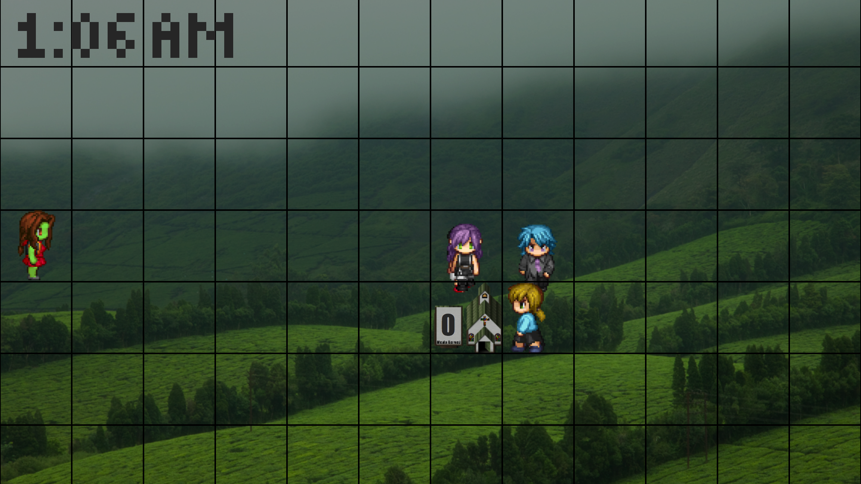
Wait!!! I just want your brains…

Slide 31
Temporal Adjusters
Predefined adjustors for common cases
First or last day of month
date.with(TemporalAdjusters.firstDayOfMonth())
First or last day of year
date.with(TemporalAdjusters.firstDayOfNextYear())
Last Friday of the month
date.with(TemporalAdjusters.lastInMonth(DayOfWeek.FRIDAY))
Custom adjusters for your own business logic

Slide 32
Friday 13th TimeAdjuster
TemporalAdjuster friday13Adjuster = temporal -> {
if (temporal.get(ChronoField.DAY_OF_MONTH) > 13) temporal = temporal.plus(1, ChronoUnit.MONTHS);
temporal = temporal.with(ChronoField.DAY_OF_MONTH, 13);
System.out.println("temporal = " + temporal);
while (temporal.get(ChronoField.DAY_OF_WEEK) != DayOfWeek.FRIDAY.getValue()) {
temporal = temporal.plus(1, ChronoUnit.MONTHS);
System.out.println("temporal = " + temporal);
}
return temporal;
};

Slide 33
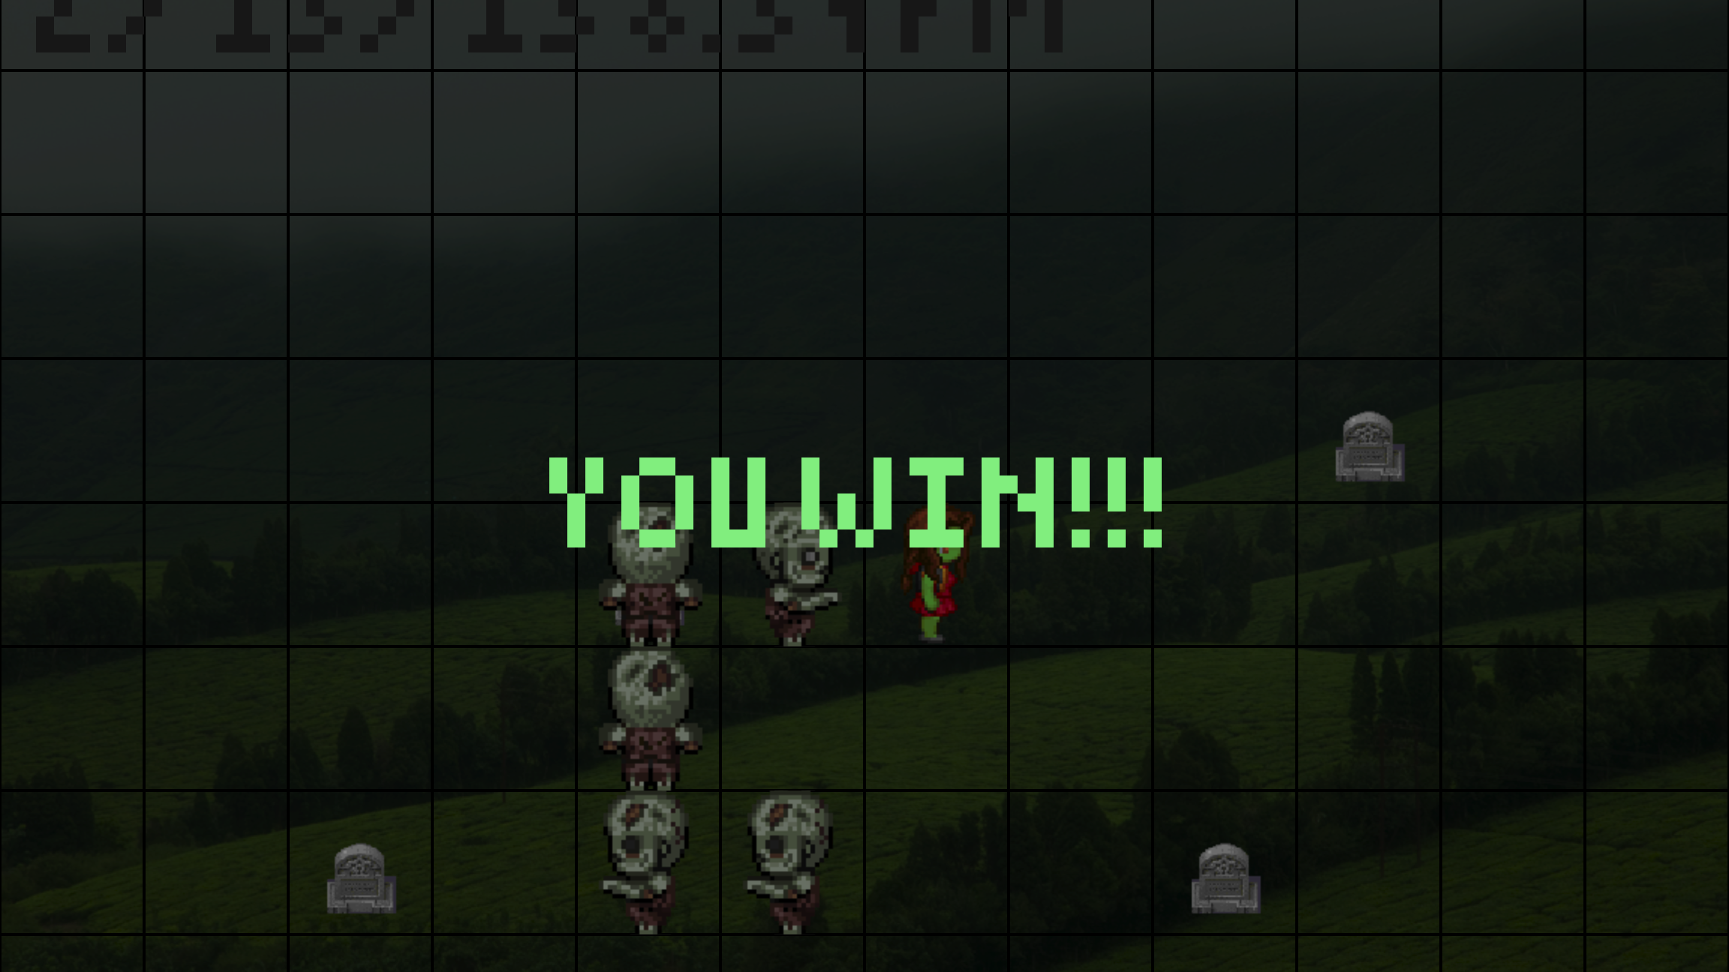
Zombified picture here…

Slide 34
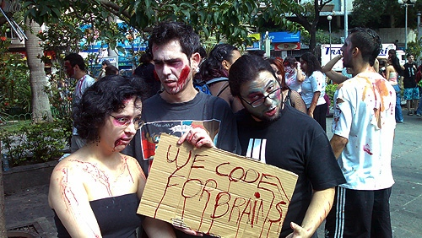
https://www.flickr.com/photos/s1mone/1833002341

Slide 35
Confessions of a Former Agile Methodologist
Stephen Chin (@steveonjava)
Java Technology Evangelist
JavaOne Conference Chair

Slide 36
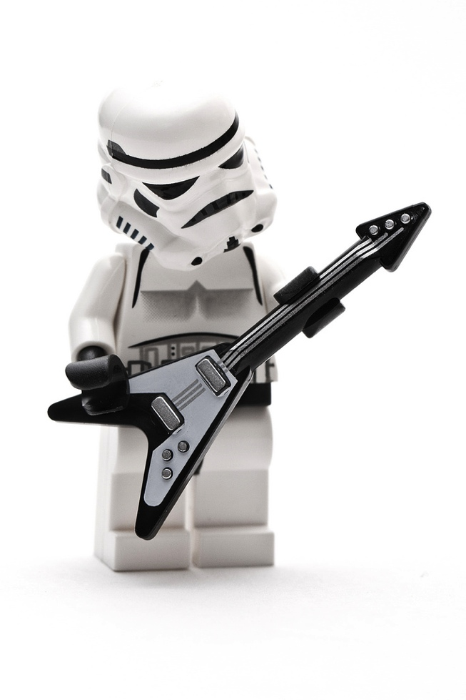
My Agile Story…
https://www.flickr.com/photos/23950335@N07/6034683535/

Slide 37
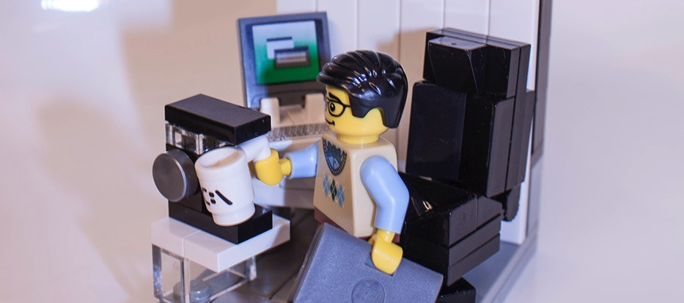
Once upon a time… I was a happy hacker
https://www.flickr.com/photos/brickpimp/8453569593/

Slide 38
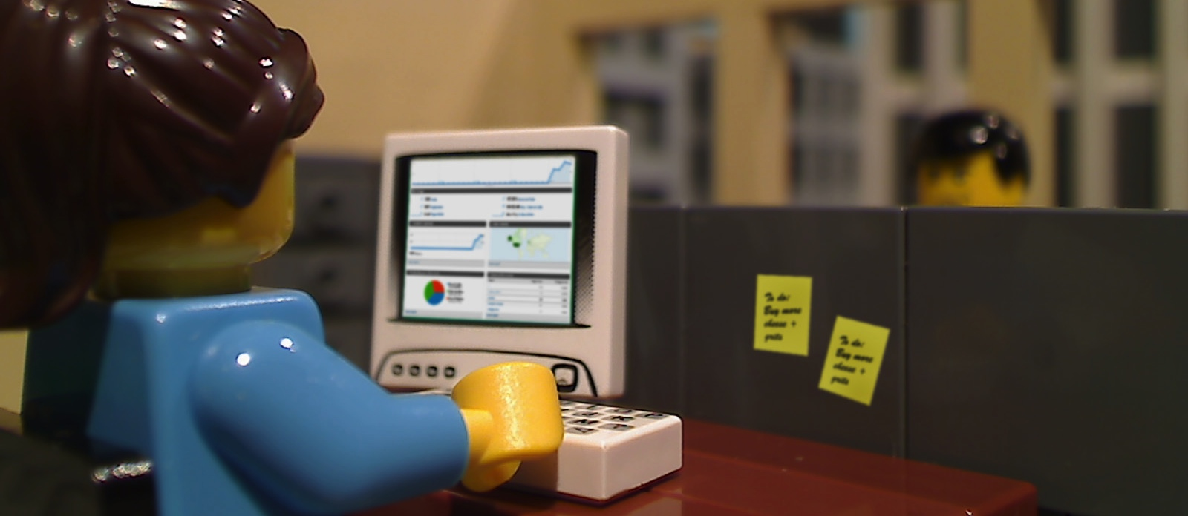
Working in teams with friendly coworkers…
https://www.flickr.com/photos/oblongpictures/5250948891/

Slide 39
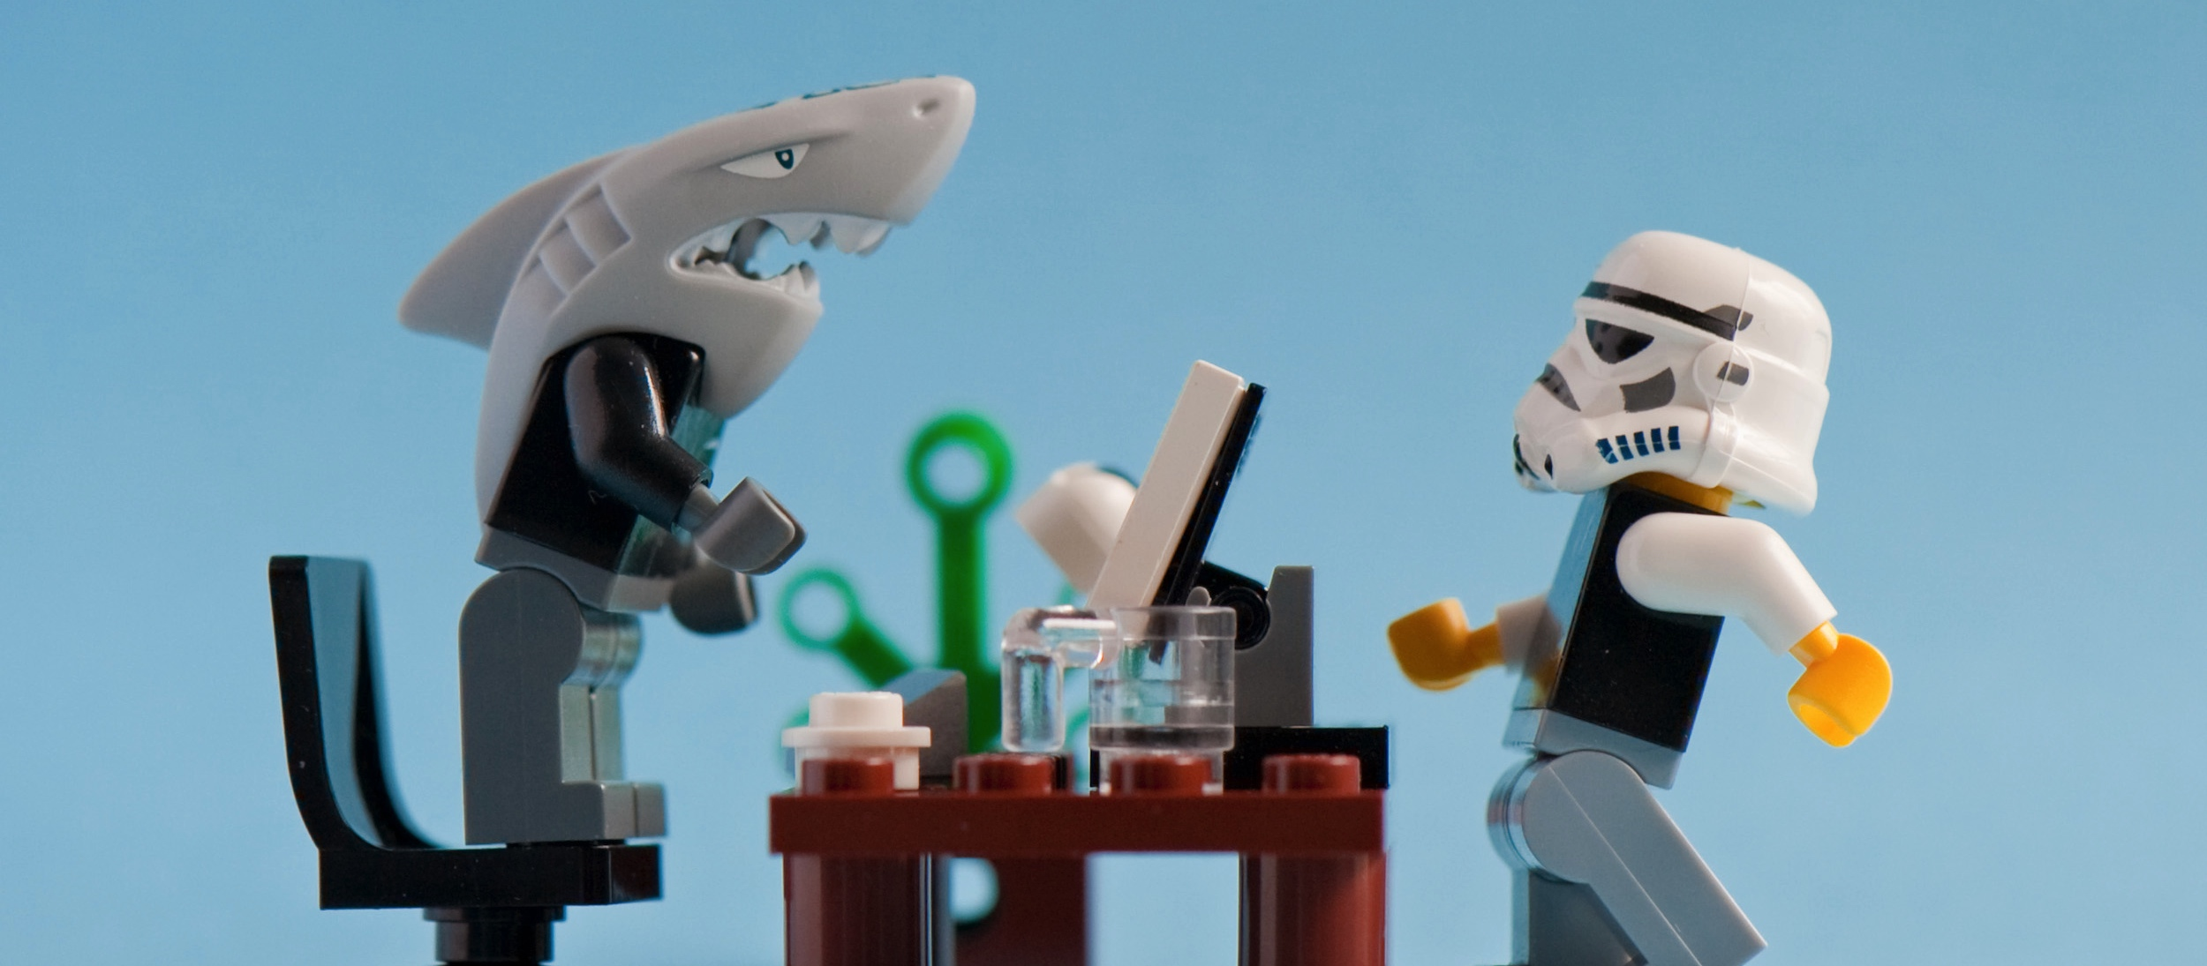
But a scary boss!
https://www.flickr.com/photos/oblongpictures/5250948891/

Slide 40


Who went on "vacation" suddenly…
https://www.flickr.com/photos/grandvelasrivieramaya/3179390917/

Slide 41

And I was left holding the banana…
https://www.flickr.com/photos/kerrythomas/14765382780/

Slide 42
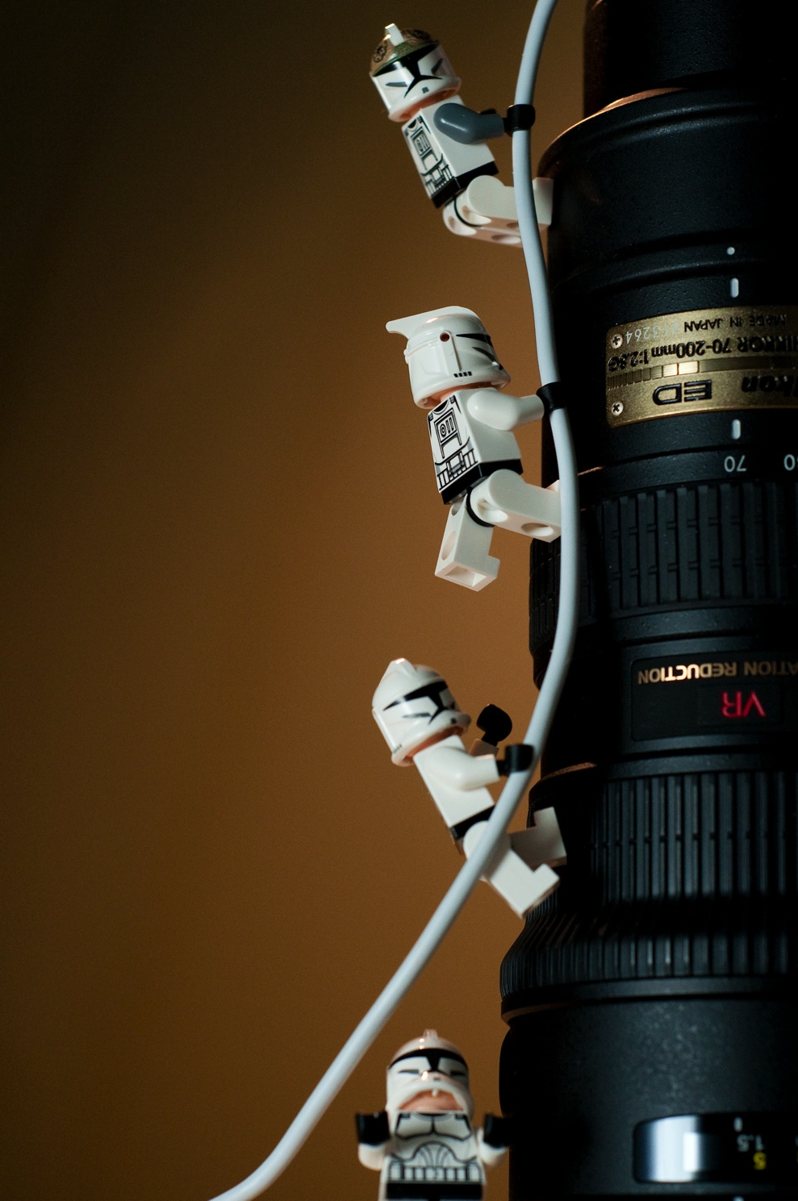
So we decided to go Extreme!
https://www.flickr.com/photos/kwl/3401221326/

Slide 43
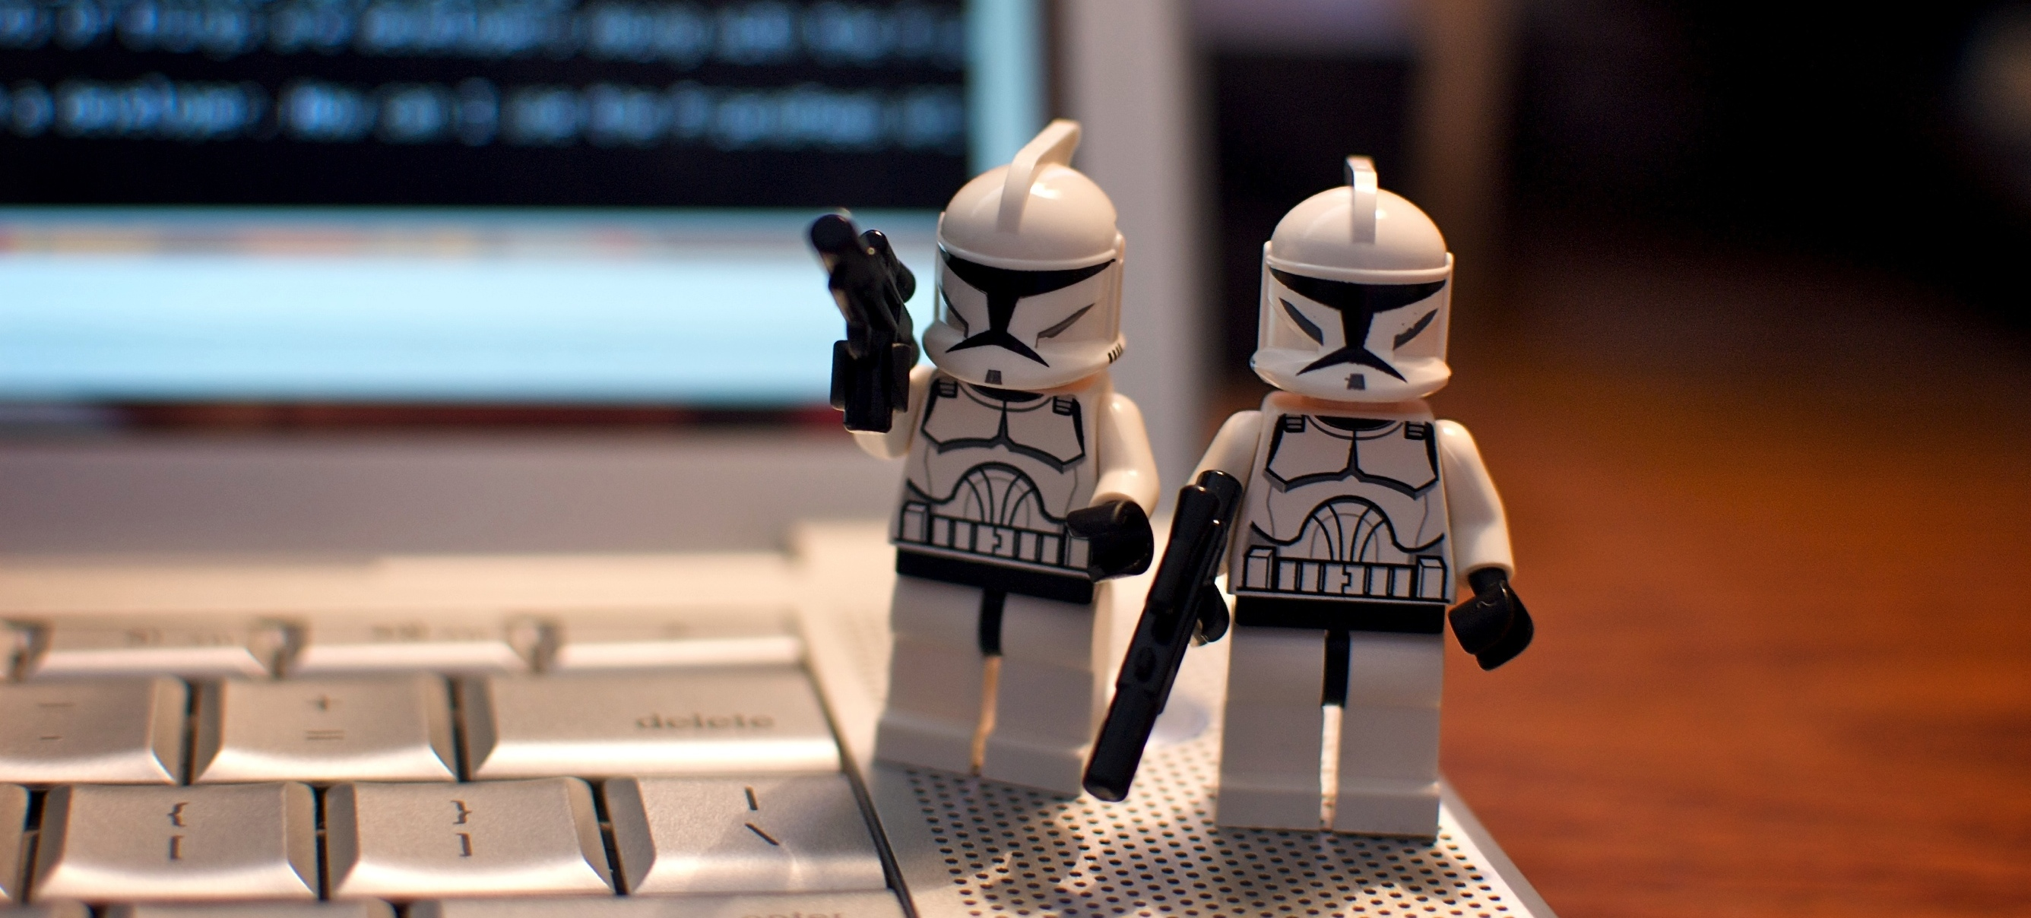
We started pair programming
https://www.flickr.com/photos/benjamingolub/3789762583

Slide 44
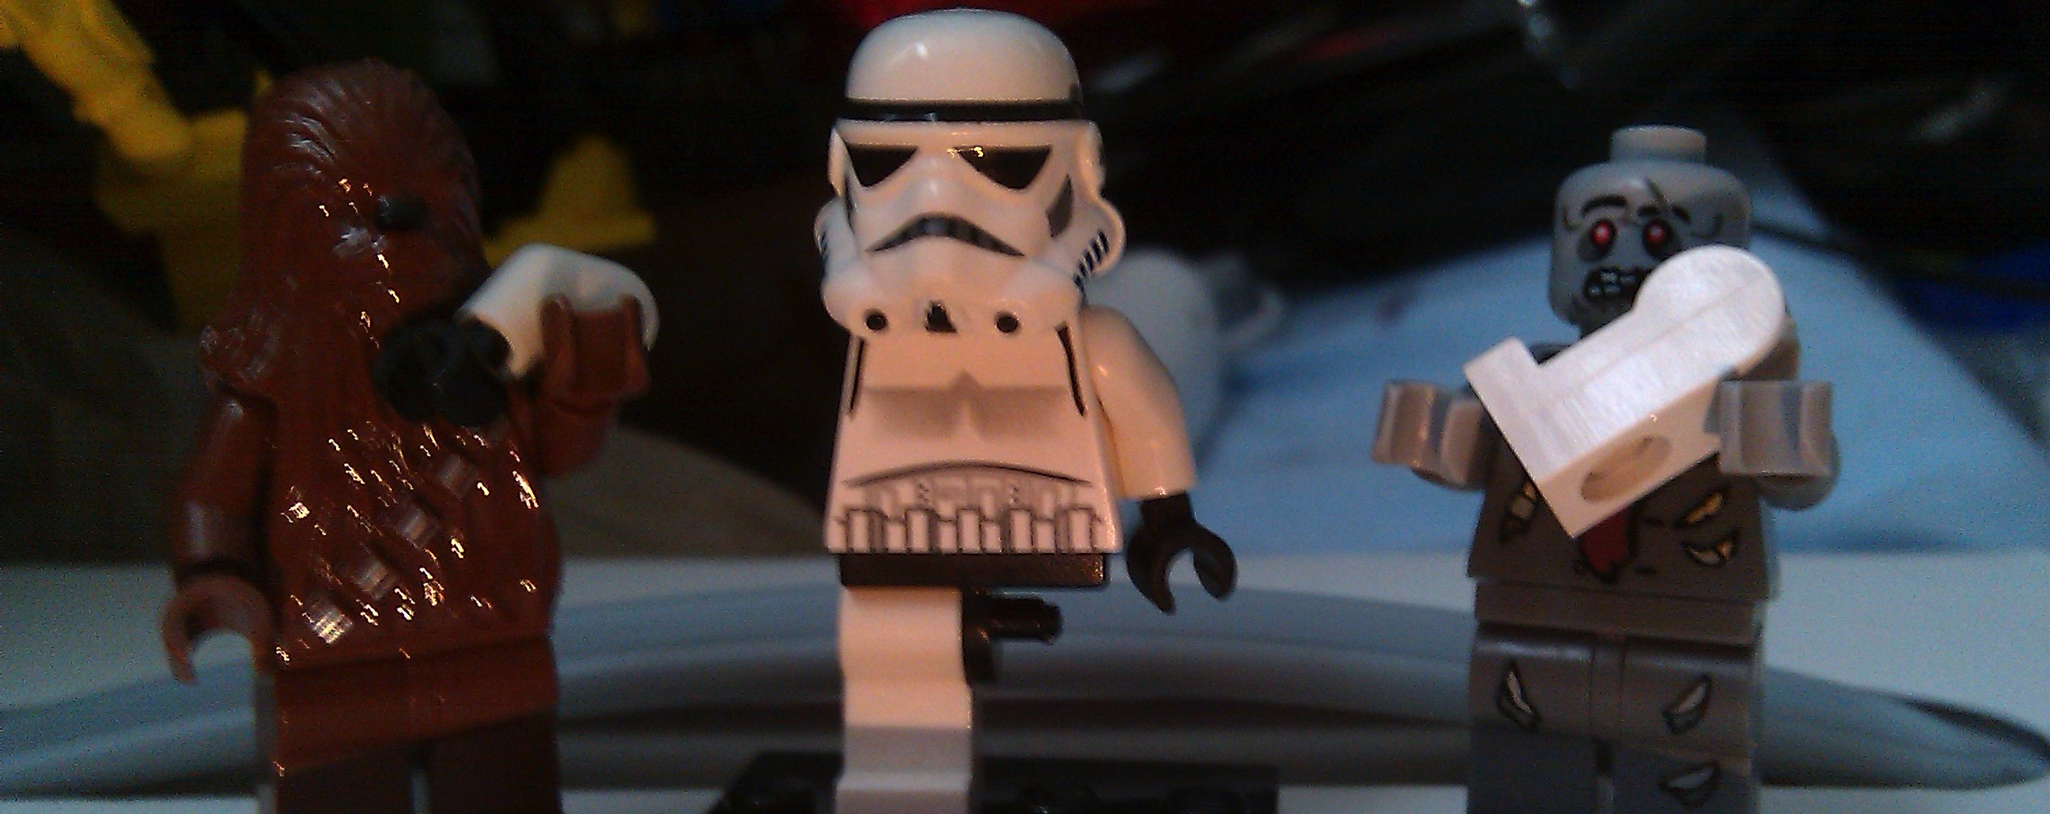
Implemented unit testing…
https://www.flickr.com/photos/magicdaddy/4706639094

Slide 45
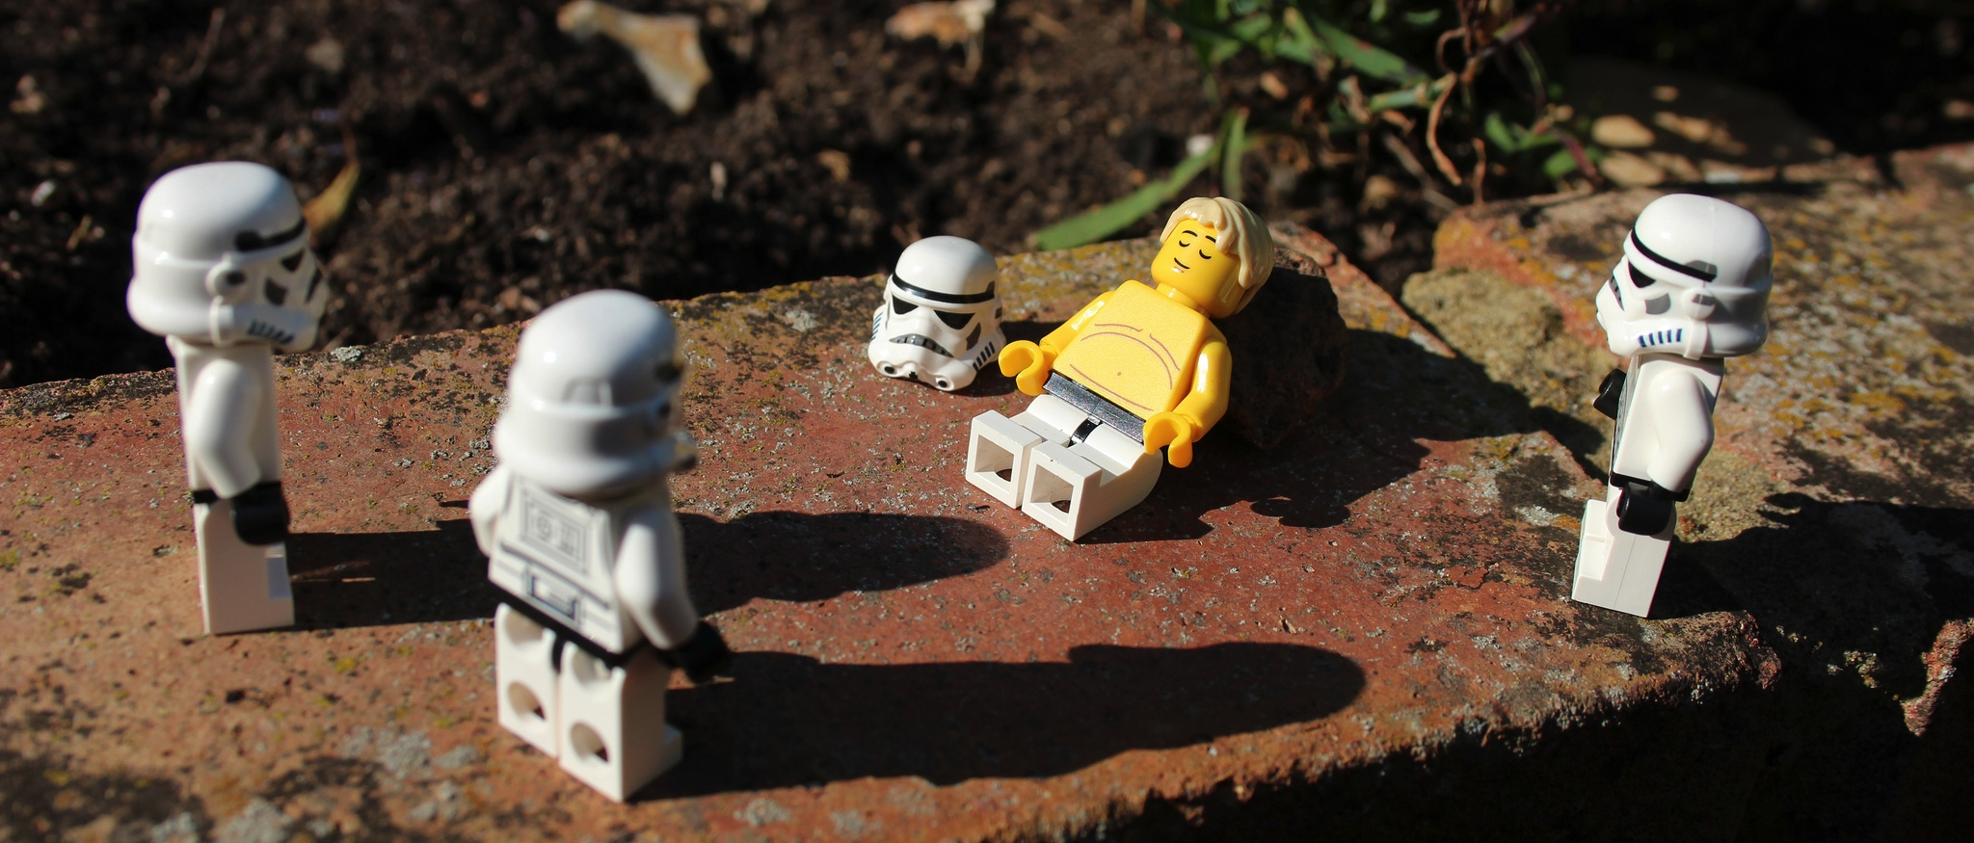
And began working at a sustainable pace.
https://www.flickr.com/photos/isherwoodchris/7653012036

Slide 46
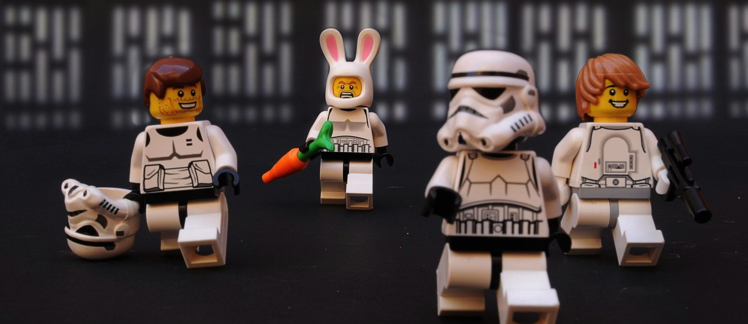
It was a lot of fun, and we were very productive

Slide 47
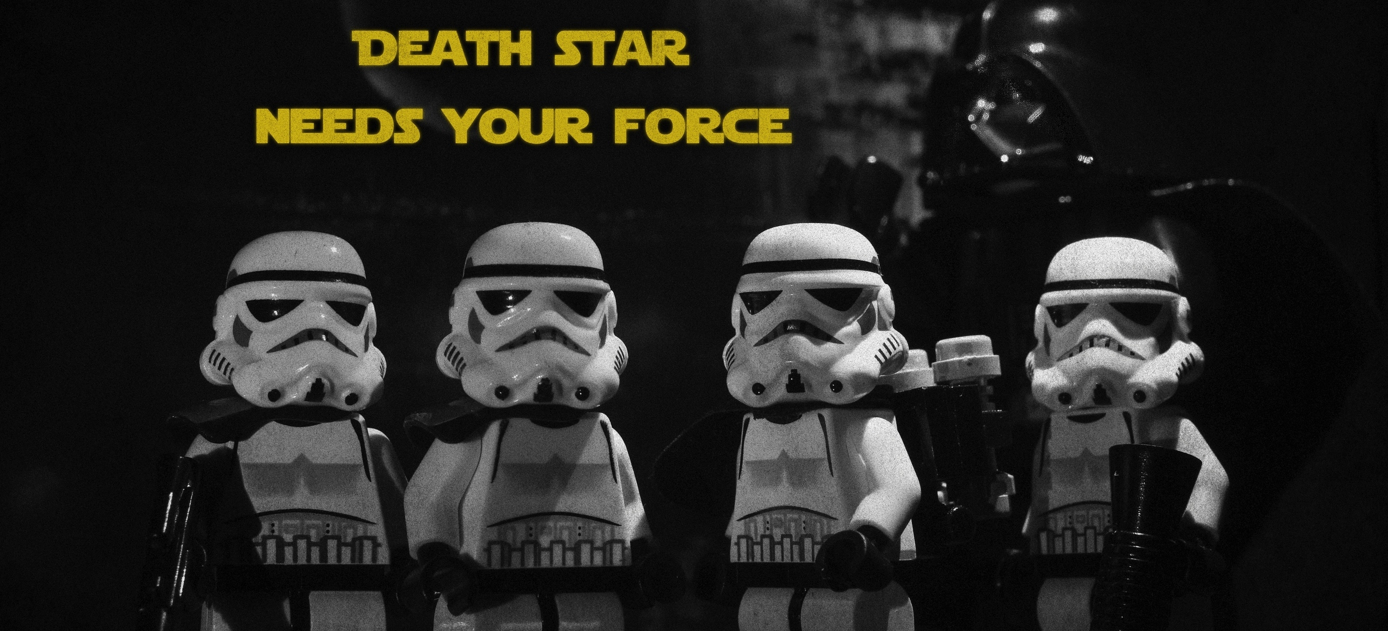
Then I set out to join the empire!
https://www.flickr.com/photos/activars/6616140577

Slide 48
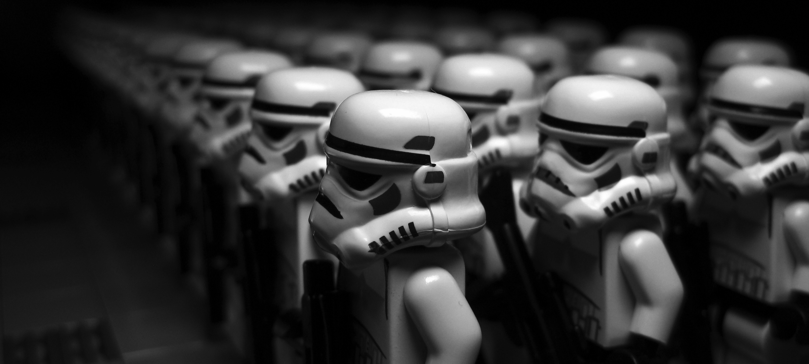
It was a little daunting at first…
https://www.flickr.com/photos/legofenris/4641828205/

Slide 49
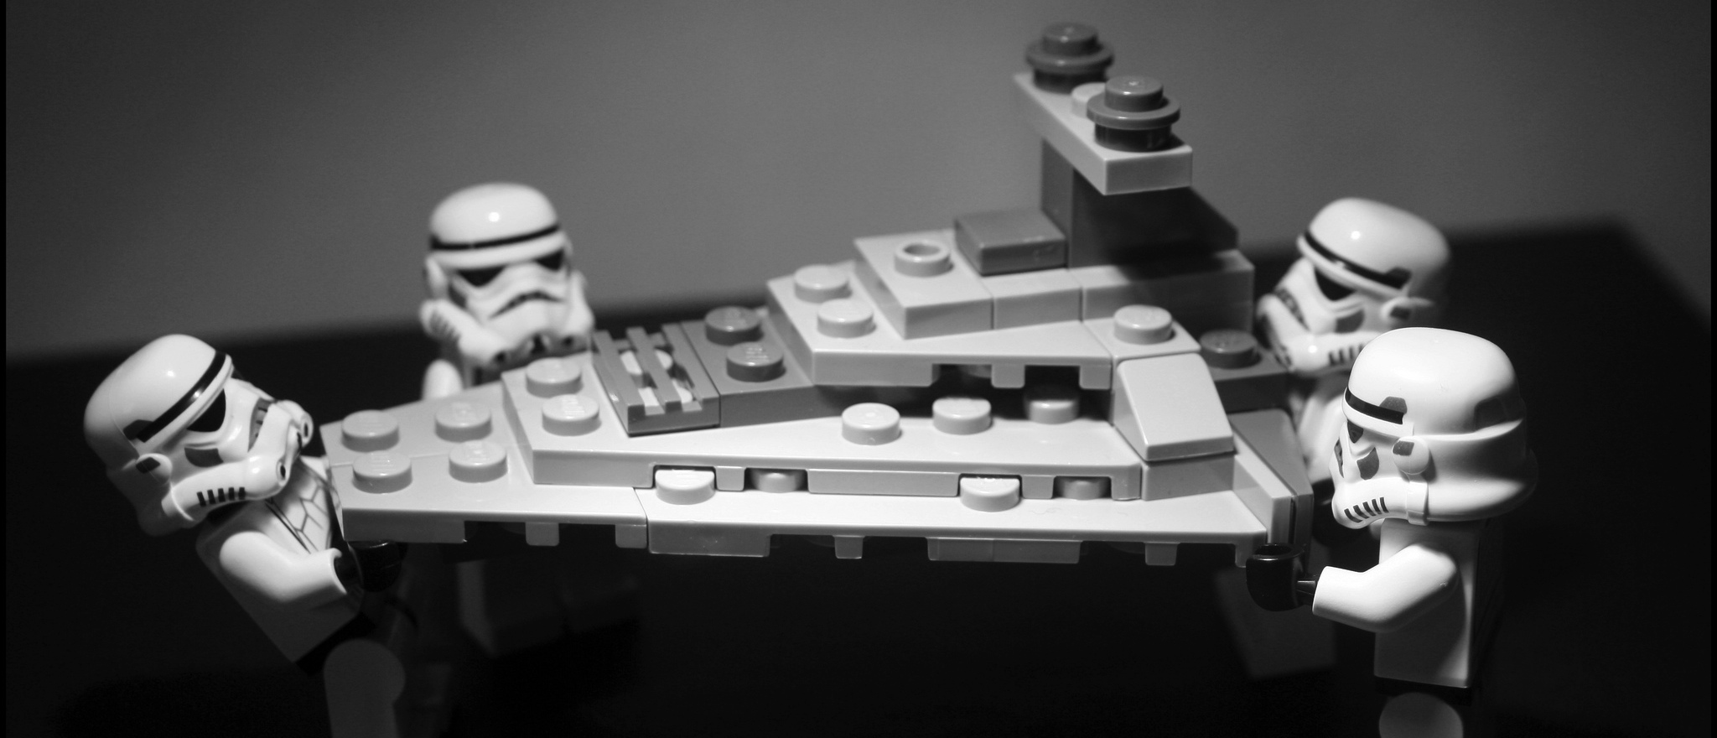
But we had good teams
https://www.flickr.com/photos/isherwoodchris/7322132364/

Slide 50
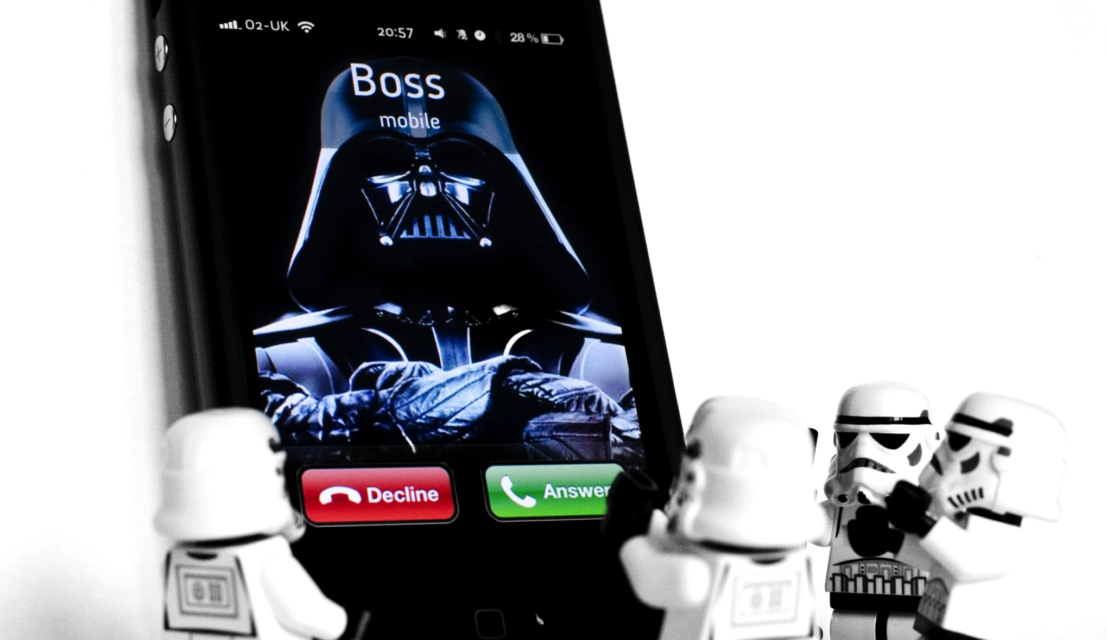
One day the boss called… and wanted my help to implement Agile

Slide 51
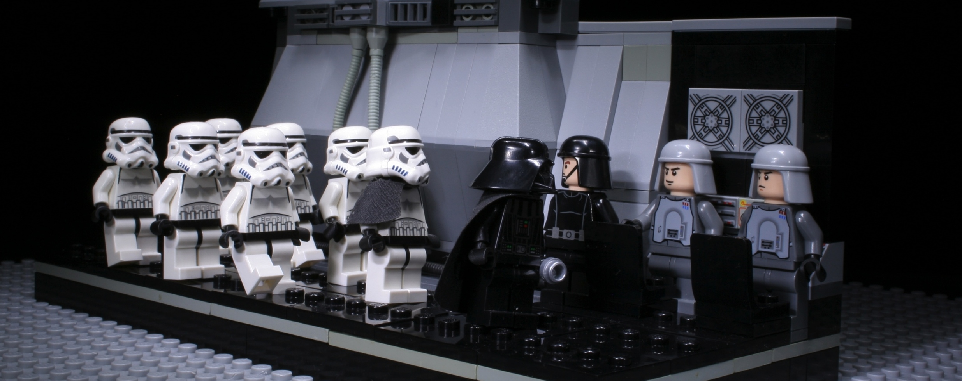
So we started a mission to convert the organization
https://www.flickr.com/photos/prodiffusion/5714174718

Slide 52
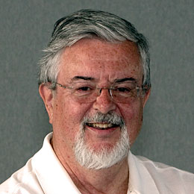

With the help of a few elites, like Ron Jeffries
https://www.flickr.com/photos/s3a/5153797926/

Slide 53
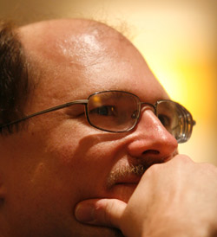
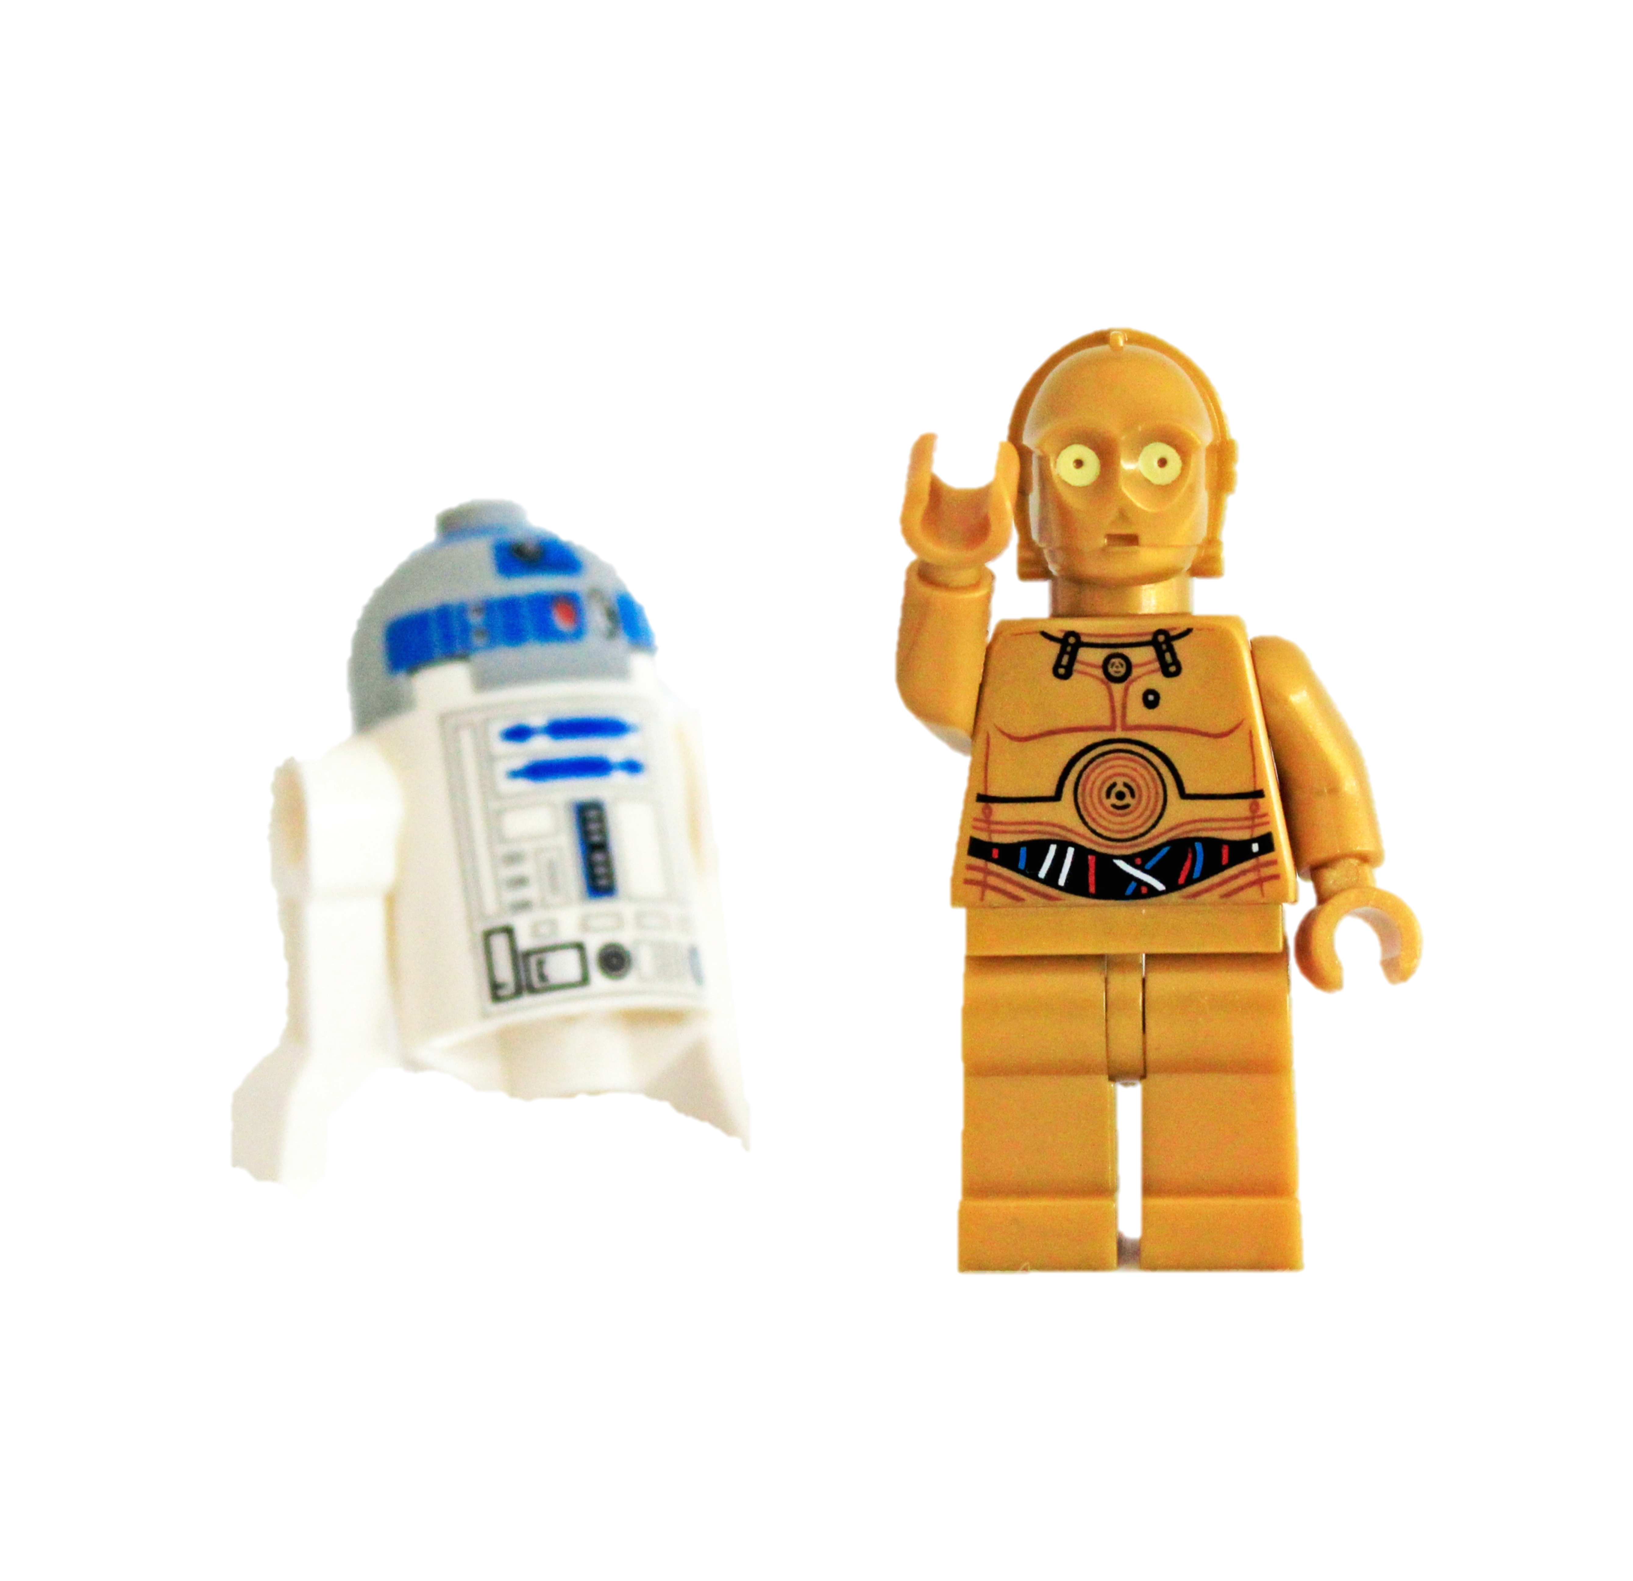
Brian Marick
https://www.flickr.com/photos/pedrovezini/6952413753/

Slide 54
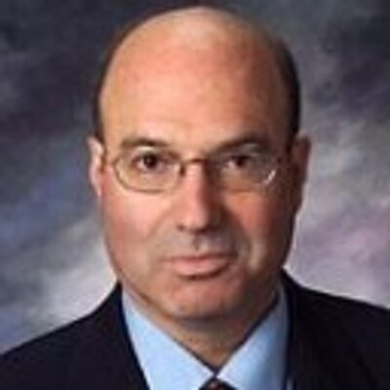

And Israel Gat
https://www.flickr.com/photos/pasukaru76/5152497973/

Slide 55
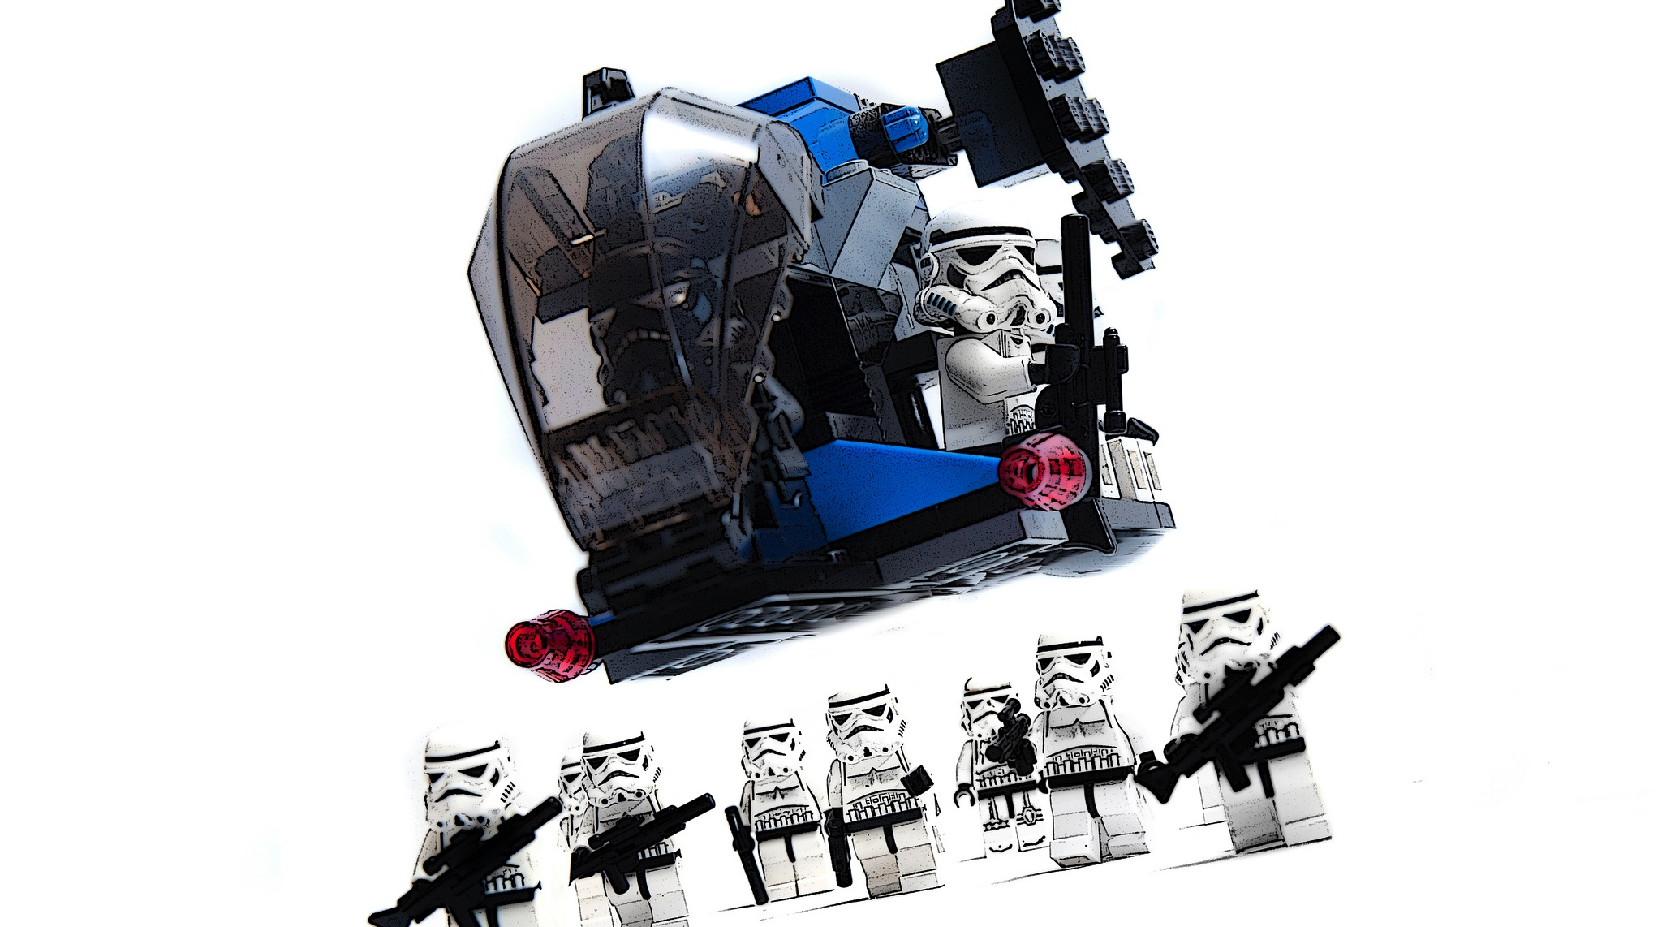
We created hyper performing teams
https://www.flickr.com/photos/23950335@N07/6950128894/

Slide 56
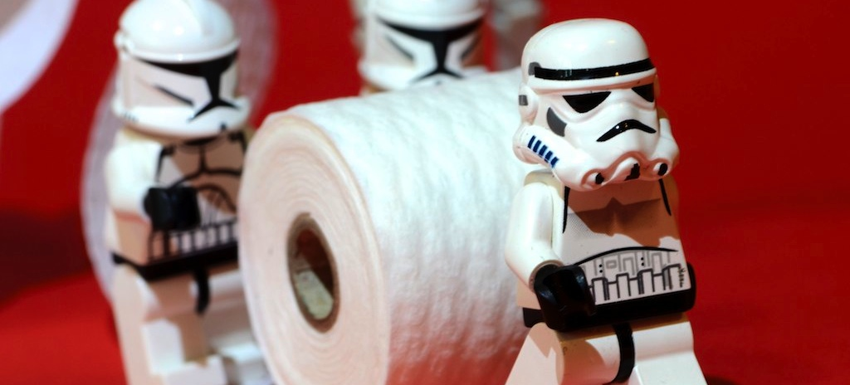
Rolled out new development practices
https://www.flickr.com/photos/kalexanderson/5765576376/

Slide 57
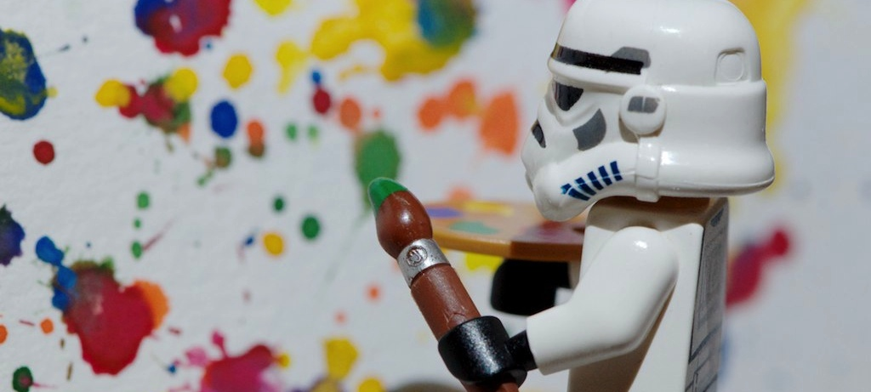
And let the troops get creative
https://www.flickr.com/photos/kalexanderson/6113247118/

Slide 58
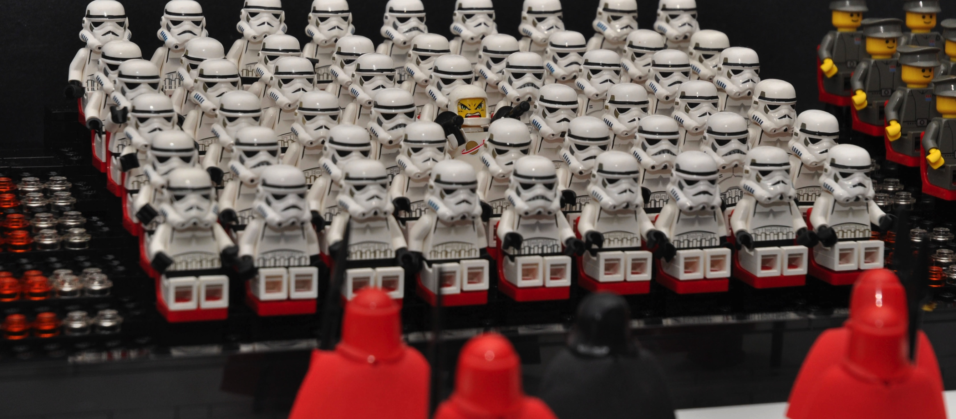
There were some dissenters…
https://www.flickr.com/photos/si-mocs/5593371079

Slide 59
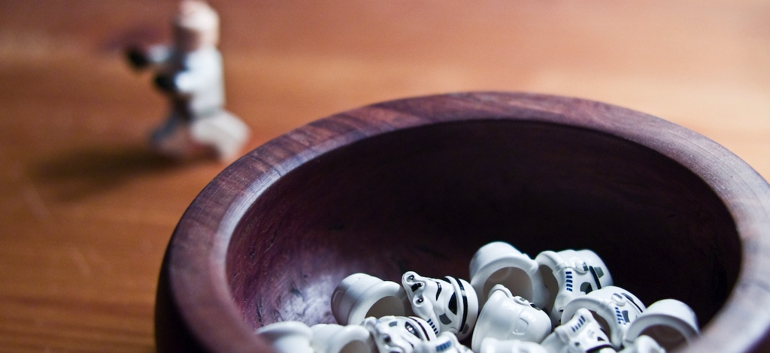
But a few heads rolling didn't slow us down…
https://www.flickr.com/photos/s3a/2064339106/

Slide 60
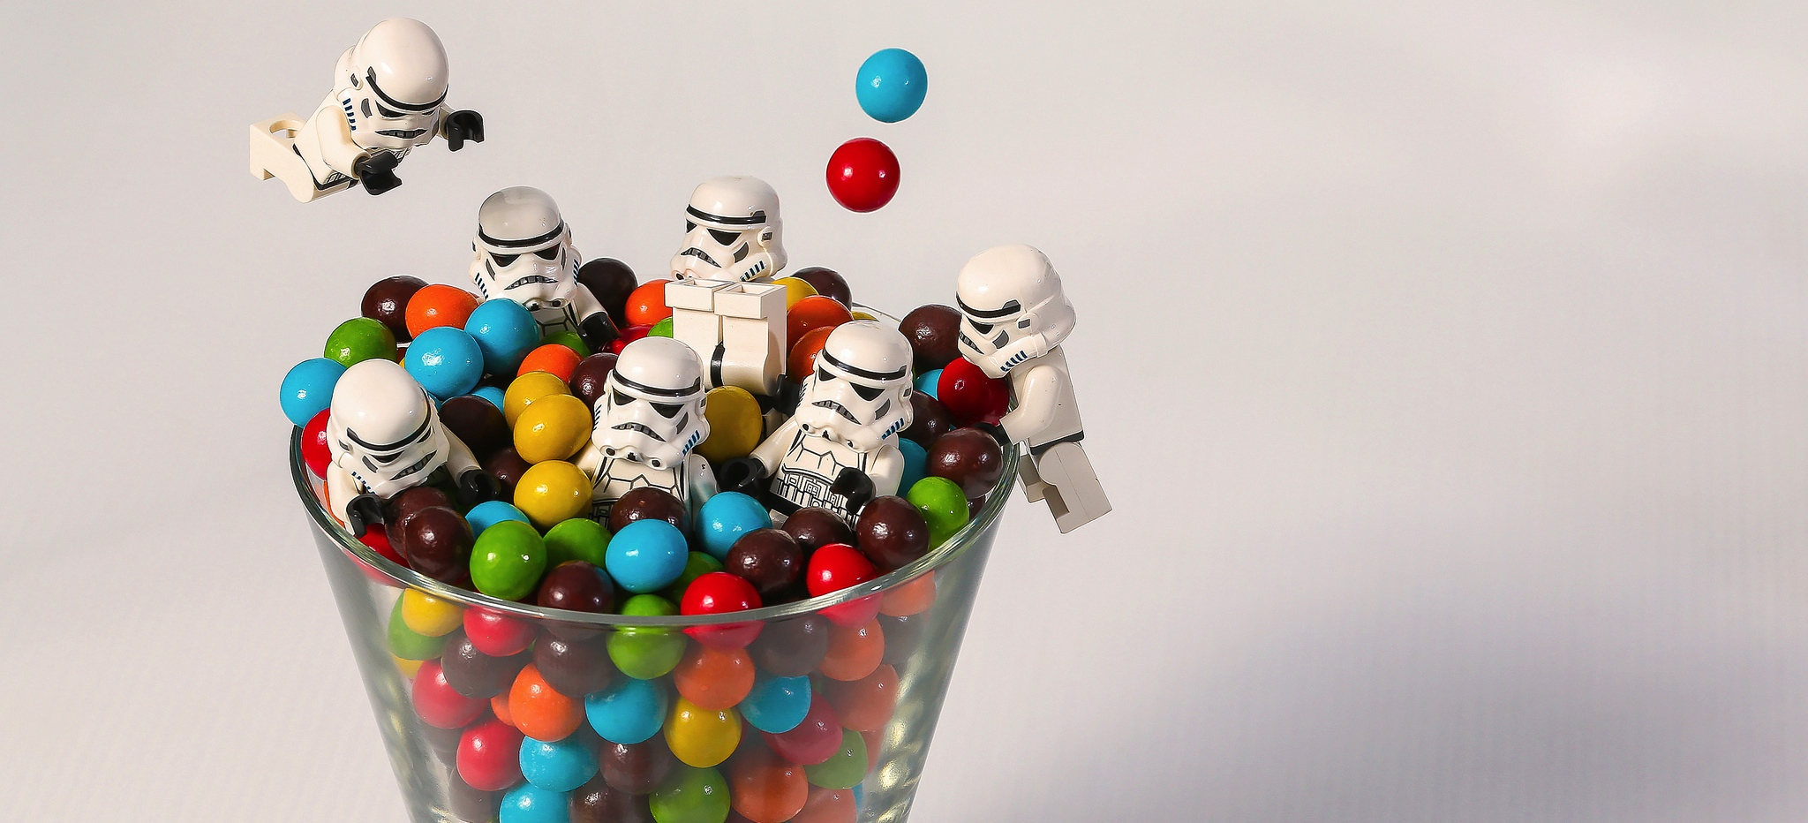
And the Agile rollout was a huge success!
https://www.flickr.com/photos/valiantize/11282717814/

Slide 61
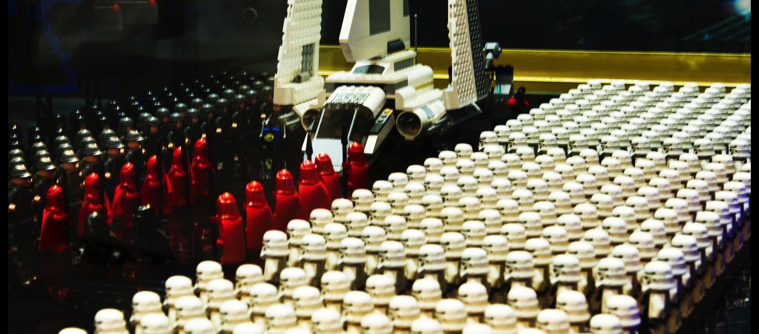
As the organization grew, we prepared a large Agile force
https://www.flickr.com/photos/jedmed/5359805561

Slide 62
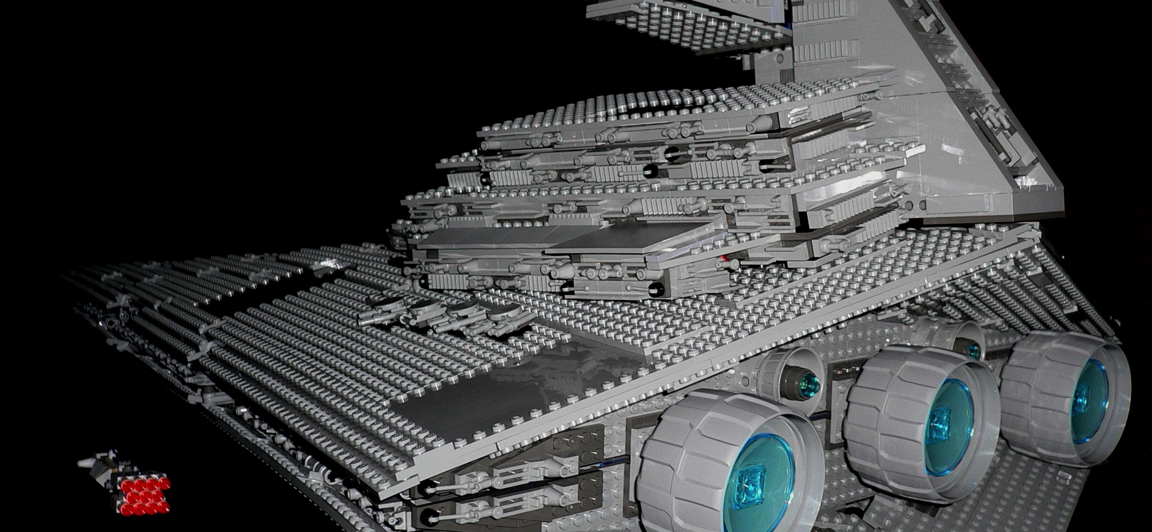
And deployed the big ships
https://www.flickr.com/photos/jurvetson/25269593

Slide 63
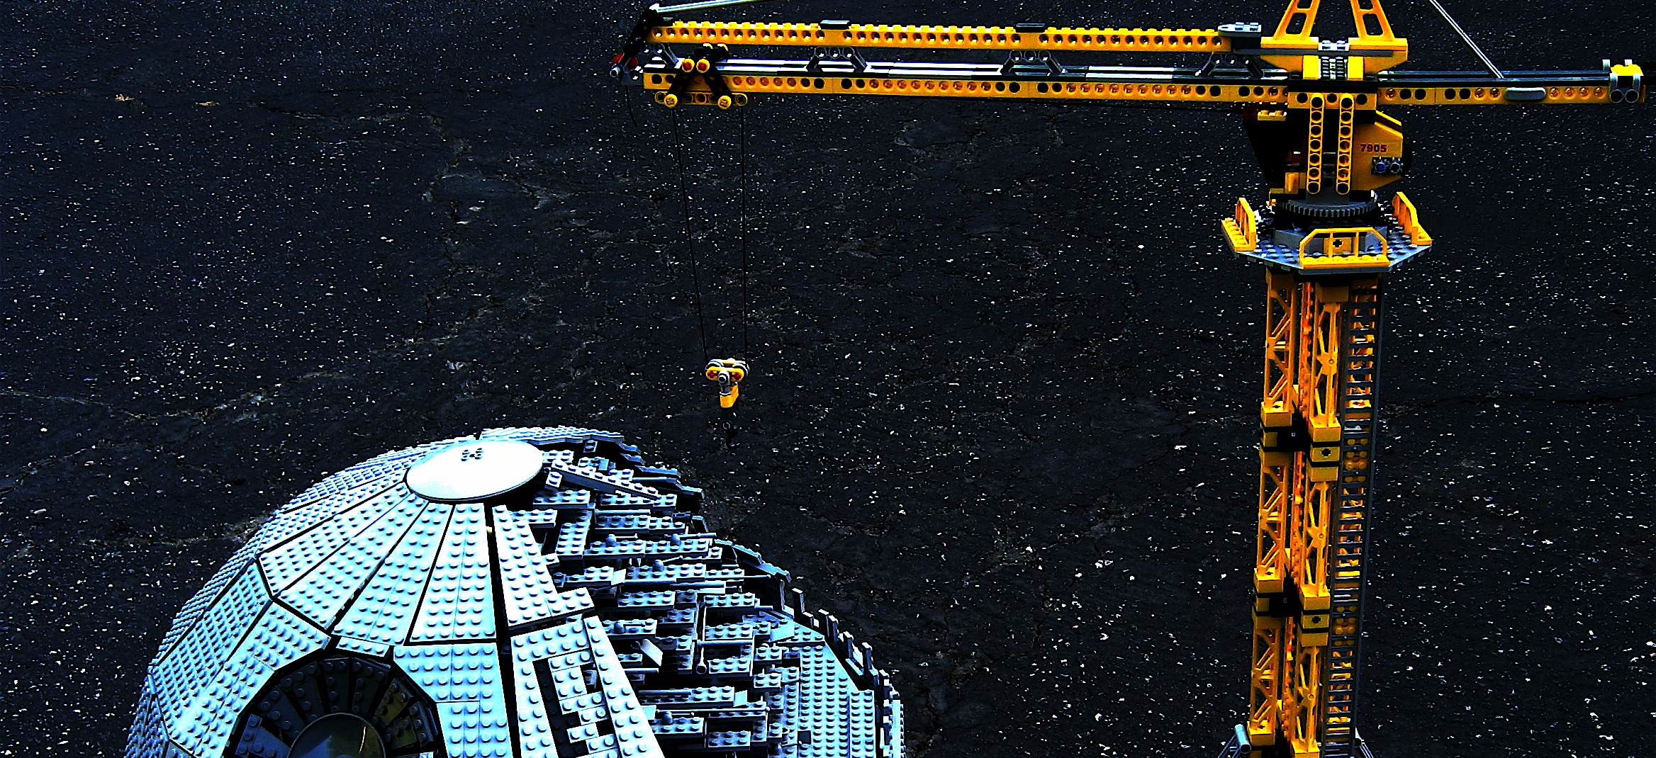
But doing Agile at large scale was a lot different
https://www.flickr.com/photos/jurvetson/542500748/

Slide 64
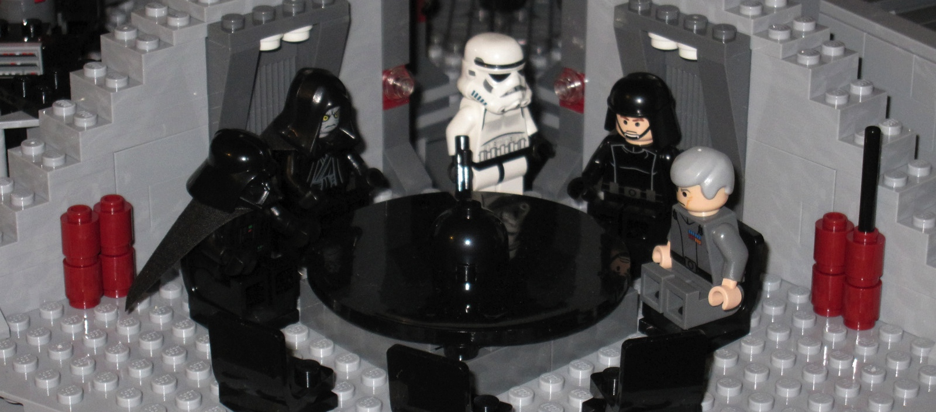
We spent most of our time in meetings…
https://www.flickr.com/photos/skinnylawyer/6884959175

Slide 65
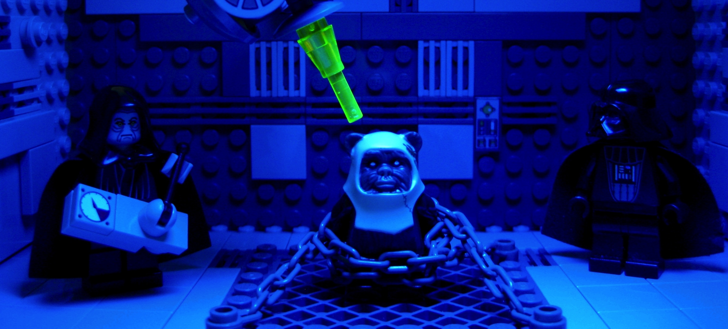
Instituted lots of "processes"
https://www.flickr.com/photos/legofenris/4776824191

Slide 66
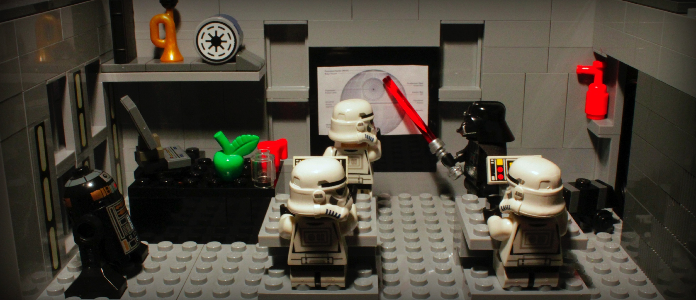
Did company-wide invasion release planning
https://www.flickr.com/photos/pedrovezini/5450412111/

Slide 67
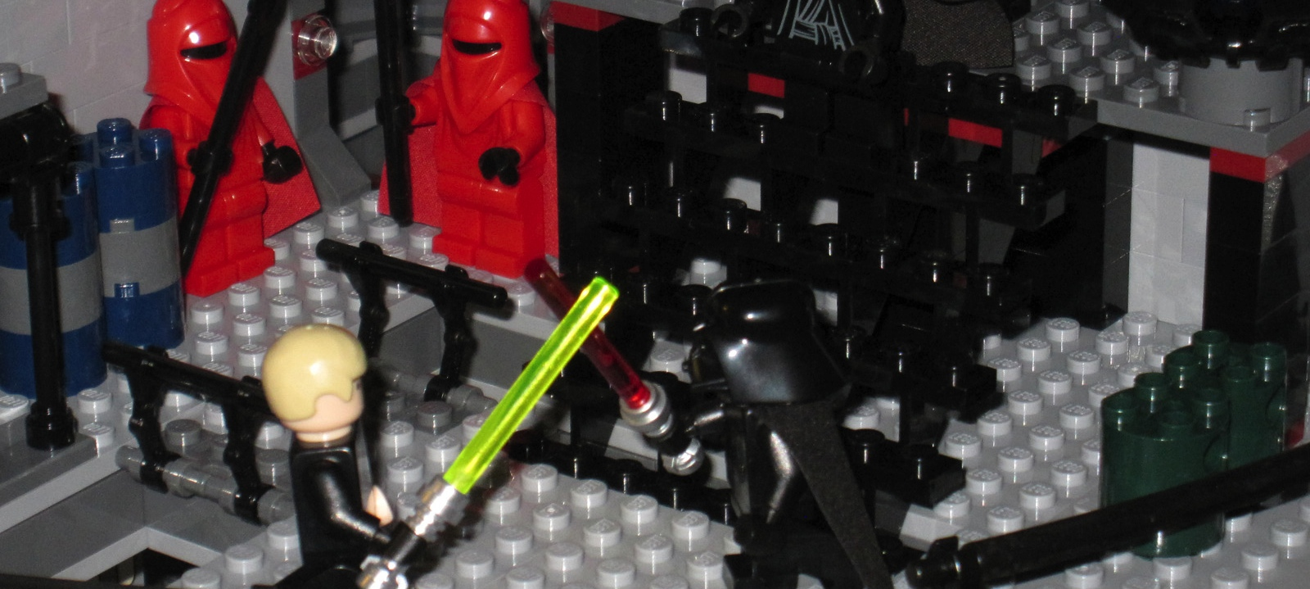
And had to resolve internal conflict
https://www.flickr.com/photos/skinnylawyer/6884960361/

Slide 68

Conquering the Universe with Agile turned out to be a lot of work!
https://www.flickr.com/photos/jurvetson/83176915/

Slide 69

So, I made my escape from the Empire
https://www.flickr.com/photos/p_valdivieso/9006007735

Slide 70

And went back to being just a normal guy…
https://www.flickr.com/photos/d35ign/11826583146

Slide 71

Some things I learned…
https://www.flickr.com/photos/23950335@N07/6032572260/

Slide 72

The Agile Manifesto
Individuals and interactions
Process and tools
over
Working software
Comprehensive documentation
over
Customer collaboration
Contract negotiation
over
Responding to change
Following a plan
over
Source: www.agilemanifesto.org

Slide 73

The Agile Industry Manifesto
Expert advice
Continuous improvement
over
Methodologies
Craftsmanship
over
Metrics
Clean code
over
Tooling licenses
In-person collaboration
over
https://www.flickr.com/photos/dieknochenblume/8454004839

Slide 74
The Agile Industry Manifesto
Expert advice
Continuous improvement
over
Methodologies
Craftsmanship
over
Metrics
Clean code
over
Tooling licenses
In-person collaboration
over
https://www.flickr.com/photos/dieknochenblume/8454004839

Slide 75

ALL YOUR BASE ARE BELONG TO US.
Source: http://setandbma.wordpress.com/2012/03/23/agile-history/

Slide 76







No shortage of Agile books!

Slide 77

But they are not a substitute for experience
https://www.flickr.com/photos/nasamarshall/12815430035

Slide 78
How do you know things have gone wrong?
According to Chapter 5, Section 3, Verse 13 of the Agile Bible…
Expert XXX has a hyper performing team with 3 hour Sprints, so we need to do that!
Same issue comes up in the retrospective… for 3 weeks running!

Slide 79

Confession Time…
I have trouble disagreeing with Ron… maybe it is the gray beard.
The guy who forced all your Sprint lengths to line up – yeah, that was me implementing what Dean recommended.
I hate retrospectives! – I would much rather be coding. ☺
https://www.flickr.com/photos/38463026@N04/3925480958

Slide 80
The Agile Industry Manifesto
Expert advice
Continuous improvement
over
Methodologies
Craftsmanship
over
Metrics
Clean code
over
Tooling licenses
In-person collaboration
over
https://www.flickr.com/photos/dieknochenblume/8454004839

Slide 81

There is a methodology for that…
Geek Hero Comic – Salvatore Iovene – "Agile Development Explained"
http://www.geekherocomic.com/2009/02/21/agile-development-explained/

Slide 82

Extreme Programming
http://www.skydive.com/photo14.htm

Slide 83

Scrum – Ready to Sprint?
https://www.flickr.com/photos/briancribb/5584373094/

Slide 84

The Kanban Treadmill
https://www.flickr.com/photos/eccampbellphotography/5447958713

Slide 85

While Pair Programming!
http://vimeo.com/9804707

Slide 86
What really makes projects fail?
Build server… yeah, that is Jonny's machine
We have unit tests… they are just manually run. And manually verified.
Software quality? Oh, that is what those guys over there do.

Slide 87

Confession Time…
I occasionally check in binaries, but that is better than not having them at all.
I trained teams on Scrum… when I should have been training them on JUnit.
All my Agile talks have been on… guess what, methodologies! (or anti-methodologies)
https://www.flickr.com/photos/lon/5582656222

Slide 88
The Agile Industry Manifesto
Expert advice
Continuous improvement
over
Methodologies
Craftsmanship
over
Metrics
Clean code
over
Tooling licenses
In-person collaboration
over
https://www.flickr.com/photos/dieknochenblume/8454004839

Slide 89

You Think You Are Independent
https://www.flickr.com/photos/sylvainkalache/14976661122

Slide 90

But you are NOT!
https://www.flickr.com/photos/nzdave/491411546

Slide 91

We are WATCHING YOU
Source: Deviant Art, created by SavageSauron
http://savagesauron.deviantart.com/art/The-Great-Eye-326927311

Slide 92
You are a metric junkie when…
You log in to the Agile tool during vacation to make sure you have a pretty burn-down chart
To keep up with the other hyper performing teams, you inflate your estimates by a factor of 10… then 100… then 1000!
Your QA team won't accept the build when the code coverage drops below 98%

Slide 93

Confession Time…
Some weeks I spent more time in Excel then my IDE. ☹
100% code coverage? I have accomplished that with 0 assertions!
I have single-handedly killed projects with pie charts.
https://www.flickr.com/photos/hoyvinmayvin/4865553148/

Slide 94
The Agile Industry Manifesto
Expert advice
Continuous improvement
over
Methodologies
Craftsmanship
over
Metrics
Clean code
over
Tooling licenses
In-person collaboration
over
https://www.flickr.com/photos/dieknochenblume/8454004839

Slide 95





Need agility? There is a tool for that…

Slide 96

Remote Teams, we have a device for that…
https://www.flickr.com/photos/mattystevenson/5818172762/

Slide 97

Bringing people together… that is costly!
https://www.flickr.com/photos/walkingsf/6635655755/

Slide 98
You have overdone the tooling when…
When the QA guy wants you to fix the coffee machine you ask him to file a bug first
The only person who writes stories in your planning meeting is the Scrum Master as he enters them in the online tool
You go into shock when you meet your team for the first time and realize you are the only guy… Pat, Alex, Kris, and even Sam are all females!

Slide 99

Confession Time…
I was one of those Scrum masters who entered in all the stories for my team.
Oh, and I also put all the estimates in for efficiency.
And I even built my own tooling and unleashed it on unwitting teams!
https://www.flickr.com/photos/blackzack00/15206347052/

Slide 100

And the most important thing!
Stick with what you are good at…
Beer
Hacking
Video

Slide 101

NightHacking Tour
Stephen Chin
tweet: @steveonjava
blog: http://steveonjava.com
Real Geeks
Live Hacking
nighthacking.com

